Slide 1
Maximus Africa Press Release

Slide 2
Business Standard – Page No 15 Date:8th August 2022

Slide 3
https://www.thehindubusinessline.com/news/world/maximus-to-set-up-new-plant-in-africa- triple-capacity/article65674086.ece
The Hindu Business Line Date:-23-07-2022

Slide 4
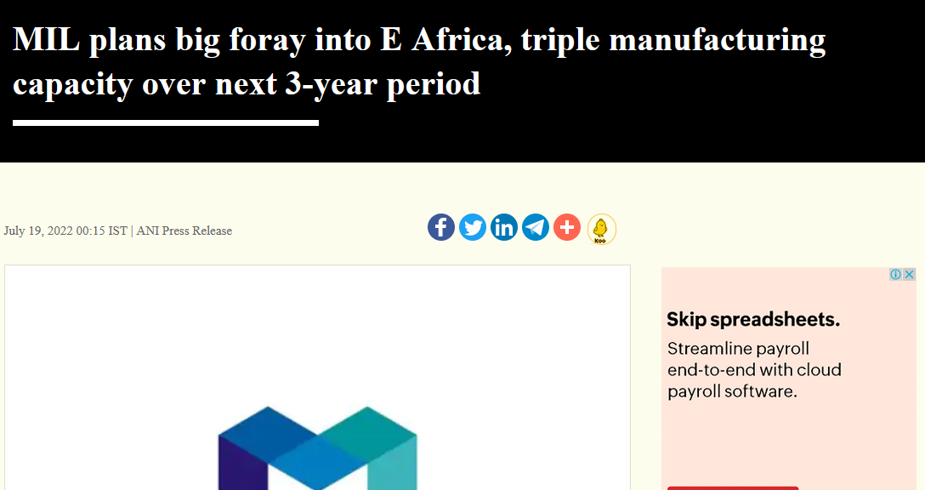
https://www.business-standard.com/content/press-releases-ani/mil-plans-big-foray-into-e-africa-triple-manufacturing-capacity-over-next-3-year-period-122072000013_1.html Business Standard

Slide 5
https://www.livemint.com/brand-stories/mil-to-foray-into-e-africa-triple-capacity-and-up-top-line-by-20-pc-in-3years-11658149312995.html Mint

Slide 6
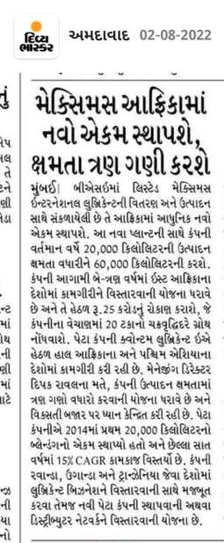
Divya Bhaskar Date:2nd August 2022

Slide 7
વડોદરાના દદવ્ય ભાસ્કરની 02-08-2022 એદડશનના આ ન્યૂઝ જરૂર વાાંચો દદવ્ય ભાસ્કર ઈ-પેપર ફ્રીમાાં વાાંચવા માટે અહી ાં દલિક કરી એપ ઈન્સ્ટોિ કરો –
https://divya-b.in/8mszqgff9rb

Slide 8
Smart Investment (Gujarat) Ahmedabad - Page No 12 Date:1st August 2022

Slide 9
Akila - Rajkot - Page No 6 Date:27th July 2022

Slide 10
The Economic Revolution (Eng) Ahmedabad Date:-25-7-22 Page 03

Slide 11
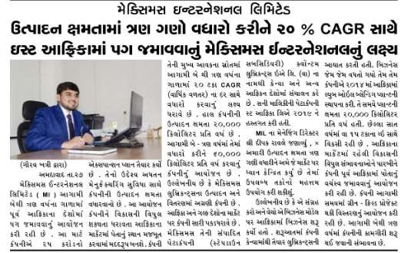
Kesari Date:-28-7-22 Page 02

Slide 12
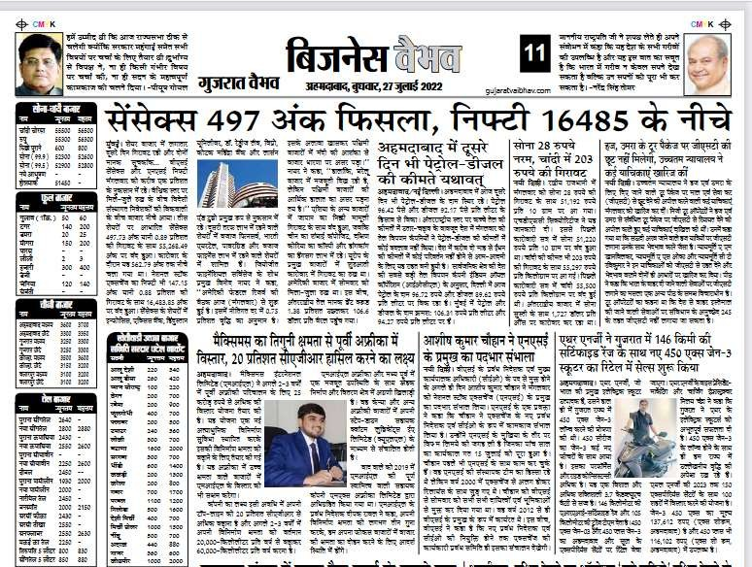
Gujarat Vaibhav Date:-27-07-2022 Page 11

Slide 13
Free press indore Date:-26-07-2022 Page 13

Slide 14
Free Press (Eng) Ahmedabad Date:-26-07-2022 Page 3

Slide 15
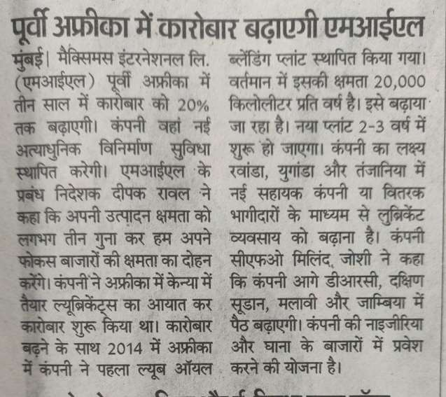
Bhaskar Date:-26-07-2022

Slide 16
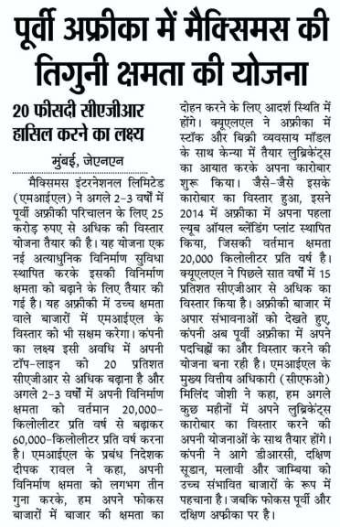
Jagran Date:-26-07-2022

Slide 17
Western Times Date:-26-07-2022 Page No 04

Slide 18
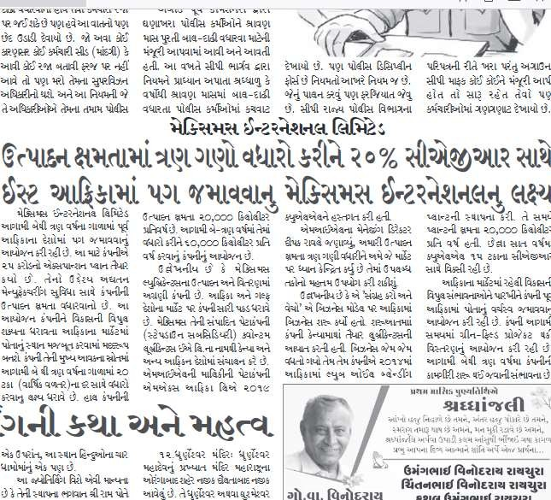
Aajkaal Date:-2-08-2022 Page No 05

Slide 19
Smart Bonanza (Guj) Ahmedabad Date 1-8-22, page no.07

Slide 20
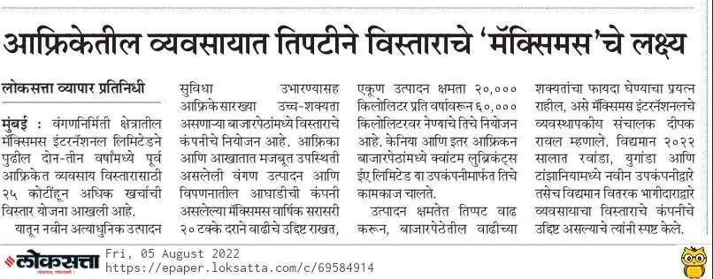
Loksatta https://epaper.loksatta.com/c/69584914

Slide 21
Other Links:

Slide 22
http://www.ptinews.com/pressrelease/56146_press-submaximus-to-triple-capacity--expand-footprint-in-east-africa--aims-to-achieve-20--cagr
https://www.aninews.in/news/business/business/maximus-to-triple-capacity-expand-footprint-in-east-africa-aims-to-achieve-20-per-cent-cagr20220715221302/
http://www.uniindia.com/maximus-to-triple-capacity-expand-footprint-in-east-africa-aims-to-achieve-20-cagr/prnewswire/news/2780703.html
https://ians.in/prnewswiredetail/maximus-to-triple-capacity-expand-footprint-in-east-africa-aims-to-achieve-20-cagr/PRN-1172408.html
https://www.theweek.in/wire-updates/business/2022/07/15/pwr25-maximus-international-ltd.html#:~:text=CAGR%20%2D%20The%20Week-,Maximus%20to%20triple%20capacity%20expand%20footprint%20in,aims%20to%20achieve%2020%20CAGR&text=VADODARA%2C%20India%2C%20July%2015%2C,next%202%2D3%2Dyears.
https://www.bloomberg.com/press-releases/2022-07-15/maximus-to-triple-capacity-expand-footprint-in-east-africa-aims-to-achieve-20-cagr
https://theprint.in/ani-press-releases/maximus-to-triple-capacity-expand-footprint-in-east-africa-aims-to-achieve-20-per-cent-cagr/1041055/

Slide 23
https://www.devdiscourse.com/article/business/2111141-maximus-to-triple-capacity-expand-footprint-in-east-africa-aims-to-achieve-20-cagr
https://www.nyoooz.com/news/vadodara/1686551/maximus-to-triple-capacity-expand-footprint-in-east-africa-aims-to-achieve-20-cagr/
https://www.newsdrum.in/business/maximus-to-triple-capacity-expand-footprint-in-east-africa-aims-to-achieve-20-cagr-59932.html
https://www.latestly.com/agency-news/business-news-maximus-to-triple-capacity-expand-footprint-in-east-africa-aims-to-achieve-20-per-cent-cagr-3955045.html
https://www.goafricaonline.com/en/np/africa-news
https://nbcnews.my.id/2022/07/16/maximus-triples-capacity-expands-footprint-in-east-africa-targets-20-cagr-nbcnews/
https://bondwithbrands.com/maximus-to-triple-capacity-expand-footprint-in-east-africa-aims-to-achieve-20-cagr/31057/
https://in.topnews.media/news/maximus-to-triple-capacity-expand-footprint-in-east-africa-aims-to-achieve-20-cagr/

Slide 24
https://www.indiasnews.net/news/272622069/maximus-to-triple-capacity-expand-footprint-in-east-africa-aims-to-achieve-20-per-cent-cagr
https://www.kolkatanews.net/news/272622069/maximus-to-triple-capacity-expand-footprint-in-east-africa-aims-to-achieve-20-per-cent-cagr
https://papernewsnetwork.com/business-news/maximus-to-triple-capacity-expand-footprint-in-east-africa-aims-to-achieve-20-cagr/
https://monzulbd.com/maximus-to-triple-capacity-expand-footprint-in-east-africa-aims-to-achieve-20-cagr/
https://indiashorts.com/maximus-to-triple-capacity-expand-footprint-in-east-africa-aims-to-achieve-20-cagr/83034/ https://worldbfn.com/prnw/?rkey=20220715EN18470&filter=23778
http://windowtonews.com/pr-newswire-english.php?rkey=20220715EN18470&filter=19687
https://news.webindia123.com/news/press_showdetailsPR.asp?id=1265469&cat=PR%20News%20Wire

Slide 25
https://uttarakhandnewsnetwork.com/press-release-pr-news-wire/?rkey=20220715EN18470&filter=14497
https://www.tripuraindia.in/press-release?rkey=20220715EN18470&filter=18753
https://theindiabizz.com/pr-newswire/?rkey=20220715EN18470&filter=22970
https://the-good.in/pr-newswire/?rkey=20220715EN18470&filter=22019
http://www.thereportingtoday.com/newswire/?rkey=20220715EN18470&filter=20784
https://thenewswatch.co.in/wp/pr-newswire/?rkey=20220715EN18470filter=20254
https://theinvestors.world/prnw/?rkey=20220715EN18470&filter=23779
https://startupreporter.in/breaking-news/press-releases/?rkey=20220715EN18470&filter=21583
https://www.sptimes.in/p/prnewswire.html?rkey=20220715EN18470&filter=23469
https://www.socialnews.xyz/pr-newswire/?rkey=20220715EN18470&filter=15405
https://smestreet.in/infocus/prnewswireindia/?rkey=20220715EN18470&filter=15935

Slide 26
https://www.sangritoday.com/prnewswire?rkey=20220715EN18470&filter=22762
https://en.sangritimes.com/prnewswire?rkey=20220715EN18470&filter=21009
https://sambadenglish.com/prnews/?rkey=20220715EN18470&filter=4968
https://reviewstreet.in/news-reviews-mobiles-gadgets-pcs-automobile/prnewswireindia/?rkey=20220715EN18470&filter=15937
https://englishnews.reporterstoday.com/pr-newswire/?rkey=20220715EN18470&filter=20068
https://reportstory.com/pr-newswire/?rkey=20220715EN18470&filter=19806
https://reportstory.com/pr-newswire/
https://reportodisha.com/press-releases/?rkey=20220715EN18470&filter=19014
https://readbox.in/pr-newswire/?rkey=20220715EN18470&filter=22117 https://www.rajasthanhorizon.com/p/prnewswire.html?rkey=20220715EN18470&filter=23459

Slide 27
http://www.ptinews.com/pressrelease/56146_press-submaximus-to-triple-capacity--expand-footprint-in-east-africa--aims-to-achieve-20--cagr
http://www.prativad.com/Newswireeng.php?rkey=20220715EN18470&filter=19411
https://www.prnewswire.com/in/news-releases/maximus-to-triple-capacity-expand-footprint-in-east-africa-aims-to-achieve-20-cagr-840189143.html
https://papernewsnetwork.com/business-news/maximus-to-triple-capacity-expand-footprint-in-east-africa-aims-to-achieve-20-cagr/#respond
https://papernewsnetwork.com/business-news/maximus-to-triple-capacity-expand-footprint-in-east-africa-aims-to-achieve-20-cagr/
https://perfectnews.live/prnewswire/?rkey=20220715EN18470&filter=21266
http://www.onenewspage.com/prnewswire.php?rkey=20220715EN18470&filter=3968
http://odisharay.com/pressreleases.php?rkey=20220715EN18470&filter=20944
http://odishanewstune.com/press-releases/?rkey=20220715EN18470&filter=19427
http://www.odishabytes.com/pr-newswire/?rkey=20220715EN18470&filter=18897

Slide 28
https://odishabarta.com/press-release/?rkey=20220715EN18470&filter=20444
https://nrinews24x7.com/pr-news/?rkey=20220715EN18470&filter=4972
https://www.newznew.com/press-releases/?rkey=20220715EN18470&filter=16908
http://www.newsr.in/prnewswire.php?rkey=20220715EN18470&filter=5070
http://www.newscontrolroom.com/pr-newswire/?rkey=20220715EN18470&filter=19537
https://www.newsblare.com/pr-newswire/?rkey=20220715EN18470&filter=20902
http://media.newswire.ca/newssuperfastblog.html?rkey=20220715EN18470&filter=10033
https://newsdeck.in/pressreleases/?rkey=20220715EN18470&filter=22015
https://newschronicle.in/pr-newswire/?rkey=20220715EN18470&filter=20256
https://www.newdelhitimes.com/news-release/?rkey=20220715EN18470&filter=5147
http://nasheman.in/newswire/?rkey=20220715EN18470&filter=11016
https://en.marudharabharti.com/p/prnewswire.html?rkey=20220715EN18470&filter=23205

Slide 29
http://www.mangalorean.com/pr-newswire/?rkey=20220715EN18470&filter=17665
https://livechronicle.in/pr-newswire/?rkey=20220715EN18470&filter=22011
https://hydnews.net/pr-newswire/?rkey=20220715EN18470&filter=20977
https://en.jalorelive.com/p/prnewswire.html?rkey=20220715EN18470&filter=23504
https://invested.one/prnw/?rkey=20220715EN18470&filter=23780
https://english.instanews24x7.com/press-releases?rkey=20220715EN18470&filter=20045
https://insightonlinenews.in/english-press-release/?rkey=20220715EN18470&filter=20283
http://indoredilse.com/english-news/?rkey=20220715EN18470&filter=10474
http://indianpowersector.com/prnews/?rkey=20220715EN18470&filter=4997
http://indiannerve.com/in-press/?rkey=20220715EN18470&filter=6492
https://www.indiatoday.in/pr-newswire?rkey=20220715EN18470&filter=4315
http://news.indiaonline.in/prnewswire?rkey=20220715EN18470&filter=4991

Slide 30
http://www.indiainfoline.com/prnewswire?rkey=20220715EN18470&filter=4993
https://imp.news/prnw/?rkey=20220715EN18470&filter=23444
https://ibtn9.com/pr-newswire/?rkey=20220715EN18470&filter=12202
https://ibgnews.com/pr-newswire-news/?rkey=20220715EN18470&filter=19585
http://www.hellomumbainews.com/hello-business/?rkey=20220715EN18470&filter=12313
https://en.hamarasamachar.in/p/prnewswire.html?rkey=20220715EN18470&filter=23471
https://groundreport.in/pr-news-english-2/?rkey=20220715EN18470&filter=20940
https://goodreport.in/pr-newswire/?rkey=20220715EN18470&filter=22013
https://goearth.in/pr-newswire/?rkey=20220715EN18470&filter=20252
https://globalprimenews.com/prnewswire/?rkey=20220715EN18470&filter=19416
https://fincorp.one/prnw/?rkey=20220715EN18470&filter=23782
https://www.falconnews.net/pr-newswire?rkey=20220715EN18470&filter=23363

Slide 31
https://earthnews4u.com/pr-newswire/?rkey=20220715EN18470&filter=20250
https://www.dkoding.in/press-release/maximus-to-triple-capacity-expand-footprint-in-east-africa-aims-to-achieve-20-cagr/
https://deccaninsider.org/prnw/?rkey=20220715EN18470&filter=23776
https://crackofdawn.in/press-release/?rkey=20220715EN18470&filter=20900
https://www.businessupturn.com/brand-post/maximus-to-triple-capacity-expand-footprint-in-east-africa-aims-to-achieve-20-cagr/
http://www.businesstoday.in/prnewswire/?rkey=20220715EN18470&filter=2418
http://www.businesssandesh.in/breaking-news/?rkey=20220715EN18470&filter=7621
http://businessnewsthisweek.com/prnews/?rkey=20220715EN18470&filter=601
http://www.biznextindia.com/pr-newswire/?rkey=20220715EN18470&filter=19403
http://www.bizwireexpress.com/showstoryPRN.php?rkey=20220715EN18470&filter=2276
http://news.biharprabha.com/prnewswire/?rkey=20220715EN18470&filter=2270

Slide 32
http://www.bangalorewaves.com/news/bangalorewaves-business-news.php?rkey=20220715EN18470&filter=2267
http://www.asianbuck.com/asianbuck-prnews/?rkey=20220715EN18470&filter=8421
https://www.agrnews.in/p/prnewswire.html?rkey=20220715EN18470&filter=23473
http://www.abhitaknews.com/english/news/press-releases.aspx?rkey=20220715EN18470&filter=1889
http://www.5dariyanews.com/Full-Story-Latest-from-PR-Newswire.aspx?rkey=20220715EN18470&filter=3325
https://www.lubesngreases.com/lubereport-emea/5_29/maximus-expands-in-east-africa/
https://twitter.com/goalsecom/status/1548567164646457344

