Slide 1
Maximus Press Release

Slide 2
Business Standard Mumbai and Ahmedabad editions. Date :-08-09-22, page no.16

Slide 3
Earned Media - Money Control - https://www.moneycontrol.com/news/business/mils-pat-q1-fy-23-up-96-plans-multi-fold-expansion-in-africa-9060531.html

Slide 4
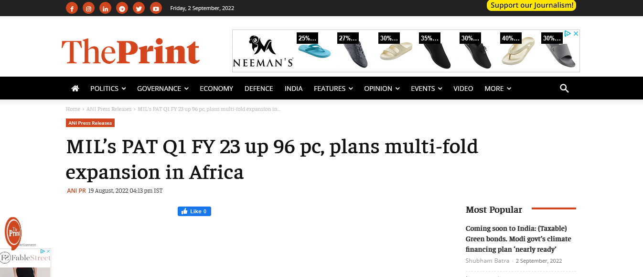
Print - https://theprint.in/ani-press-releases/mils-pat-q1-fy-23-up-96-pc-plans-multi-fold-expansion-in-africa/1089956/

Slide 5
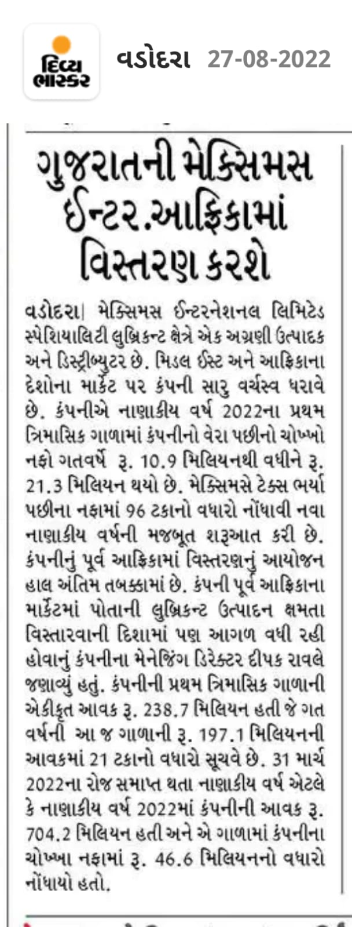
Divya Bhaskar. All major editions of Gujarat and Mumbai. Date :-27-8-22, page no.8

Slide 6
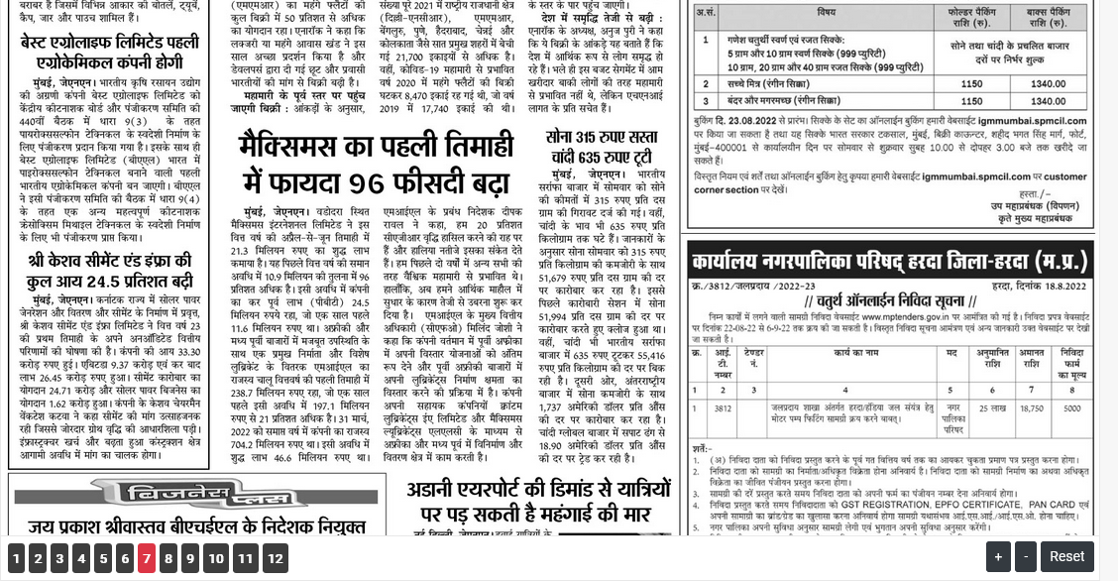
Jagran, Date :-23-8-22, page no.7 https://www.djmp.in/epaper/bhopal/2022-08-23/7

Slide 7
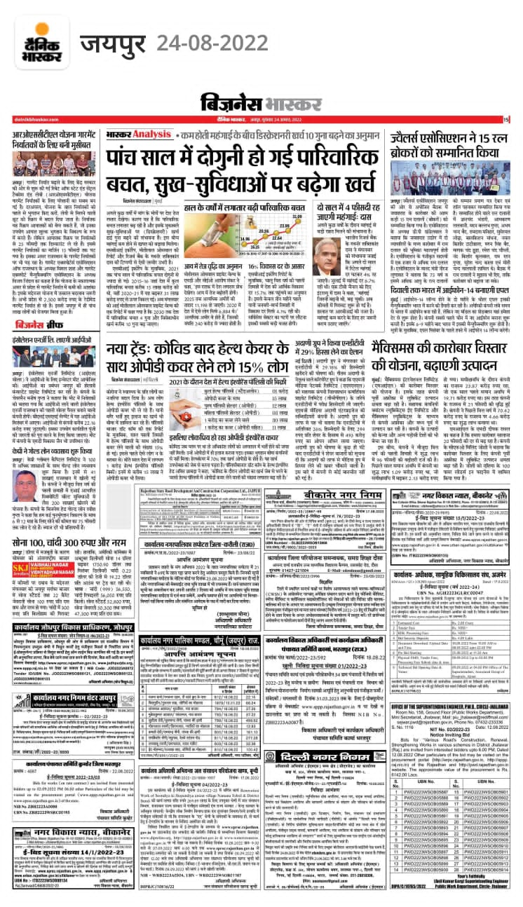
Bhaskar, Date :-24-8-22

Slide 8
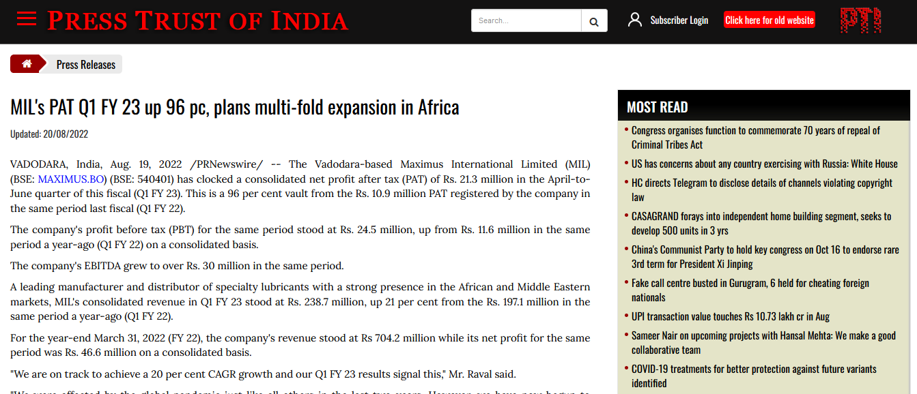
PTI - https://pti.4cplus.net/pti/MIL-s-PAT-Q1-FY-23-up-96-pc--plans-multi-fold-expansion-in-Africa/56515.html

Slide 9
ANI - https://www.aninews.in/news/business/business/mils-pat-q1-fy-23-up-96-pc-plans-multi-fold-expansion-in-africa20220819155739/

Slide 10
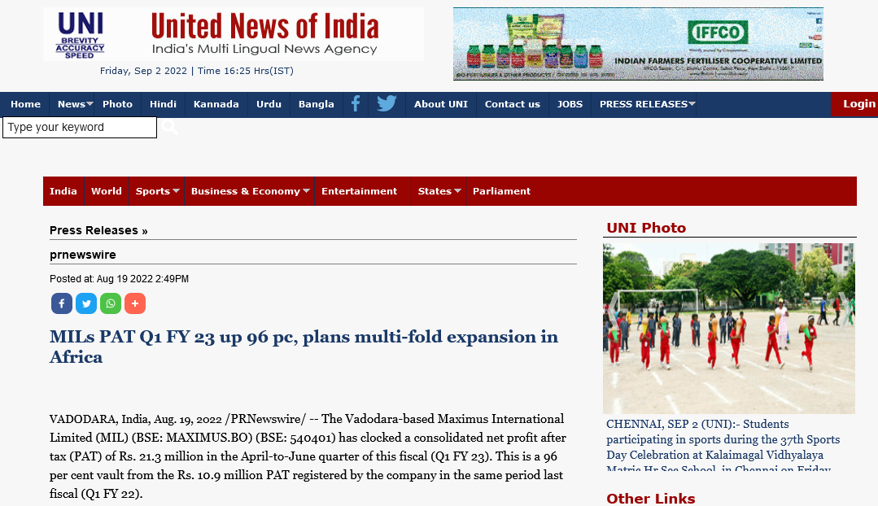
UNI - http://www.uniindia.com/mils-pat-q1-fy-23-up-96-pc-plans-multi-fold-expansion-in-africa/prnewswire/news/2804786.html

Slide 11
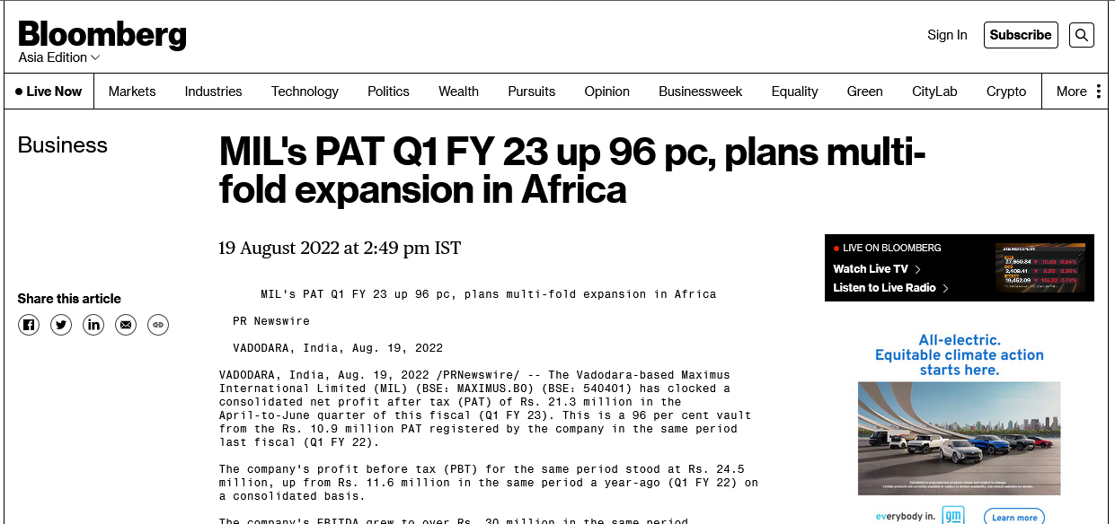
Bloomberg - https://www.bloomberg.com/press-releases/2022-08-19/mil-s-pat-q1-fy-23-up-96-pc-plans-multi-fold-expansion-in-africa

Slide 12
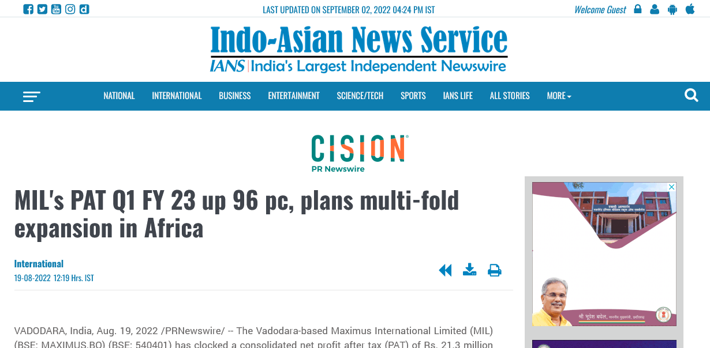
IANS - https://ians.in/prnewswiredetail/mil-s-pat-q1-fy-23-up-96-pc-plans-multi-fold-expansion-in-africa/PRN-1174187.html

Slide 13
Smallnews - https://smallnews.in/automobile/2022/08/20/mils-pat-q1-fy-23-up-96-pc-plans-multi-fold-expansion-in-africa/

Slide 14
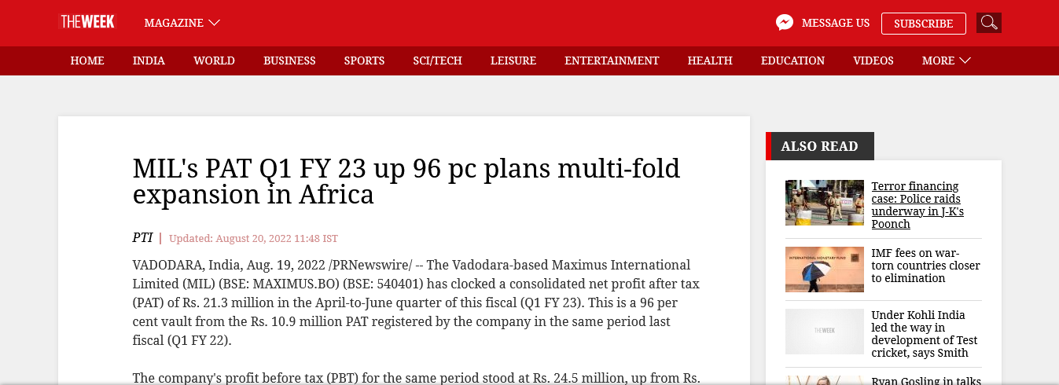
The Week - https://www.theweek.in/wire-updates/business/2022/08/20/pwr8-maximus-international-limited.html

Slide 15
IndiaShorts - https://indiashorts.com/mils-pat-q1-fy-23-up-96-pc-plans-multi-fold-expansion-in-africa/85242/

Slide 16
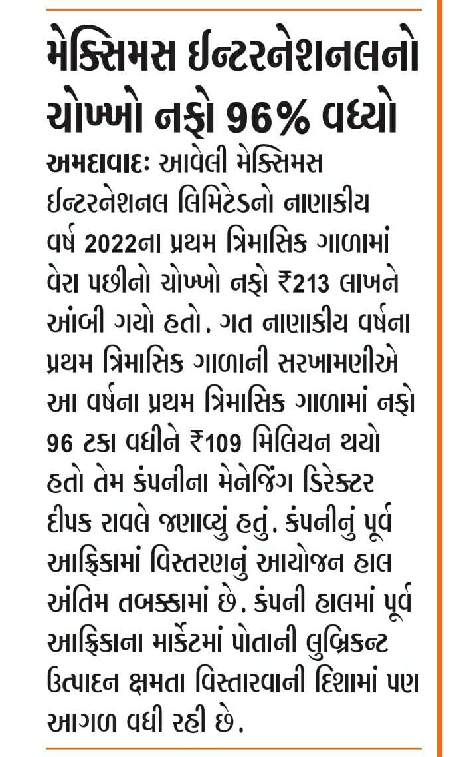
Nav gujarat

Slide 17
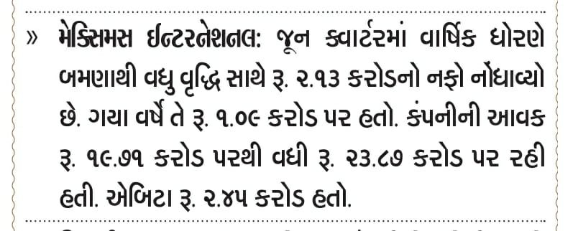
Sandesh

Slide 18
Free press (Eng) Ahmedabad Date:- 27-8-22 page no 02,

Slide 19
Kesari :- junagad , Date:- 28-8-22, page no. 04

Slide 20
Latestly - https://www.latestly.com/agency-news/business-news-mils-pat-q1-fy-23-up-96-pc-plans-multi-fold-expansion-in-africa-4100992.html

Slide 21
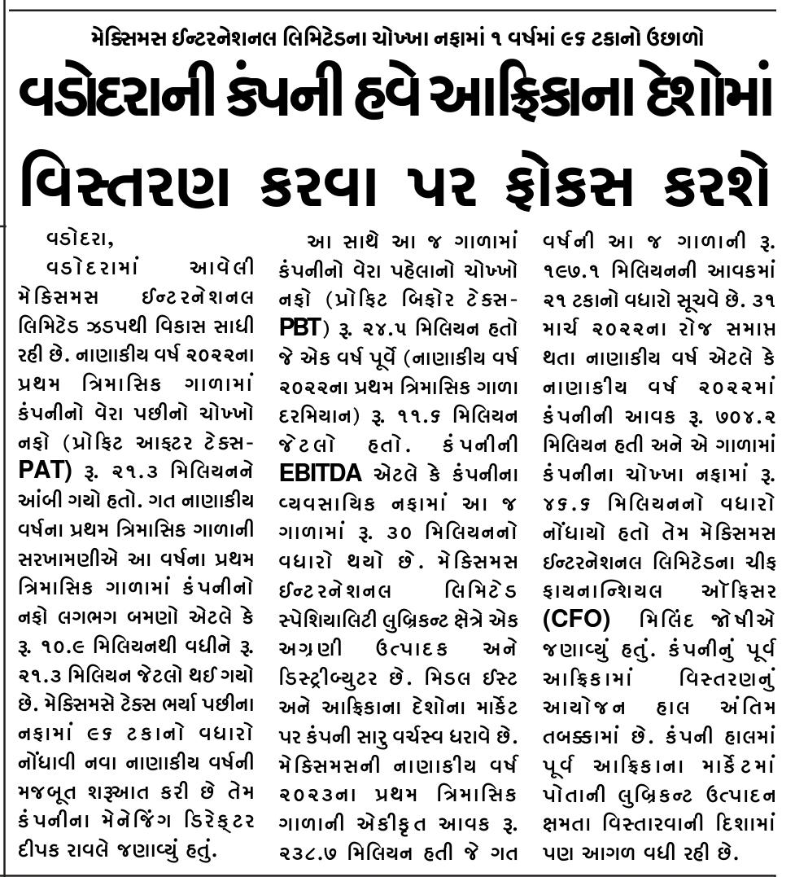
https://www.loksattanews.co.in/epaper/surat/20220827

Slide 22
https://www.loksattanews.co.in/epaper/vadodara

Slide 23
Lok Darpan Date :-25-8-22 Page No: 4

Slide 24
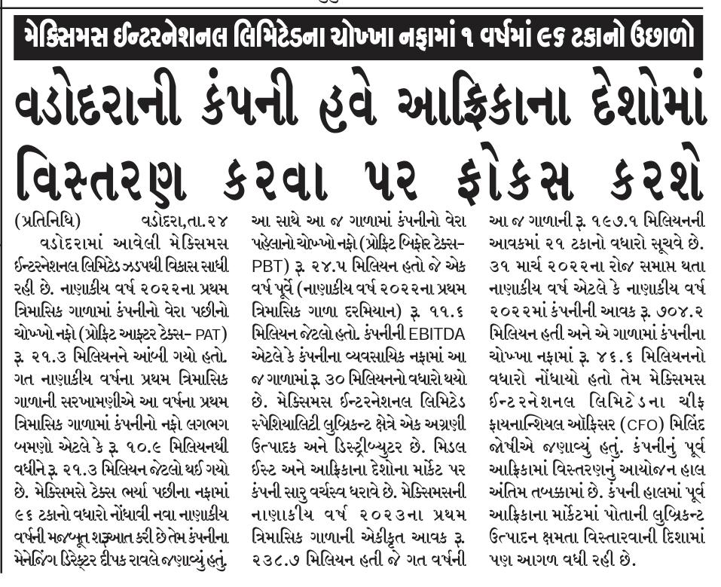
Local daily of VADODARA, Date :-25-8-22 Page No: 2

Slide 25
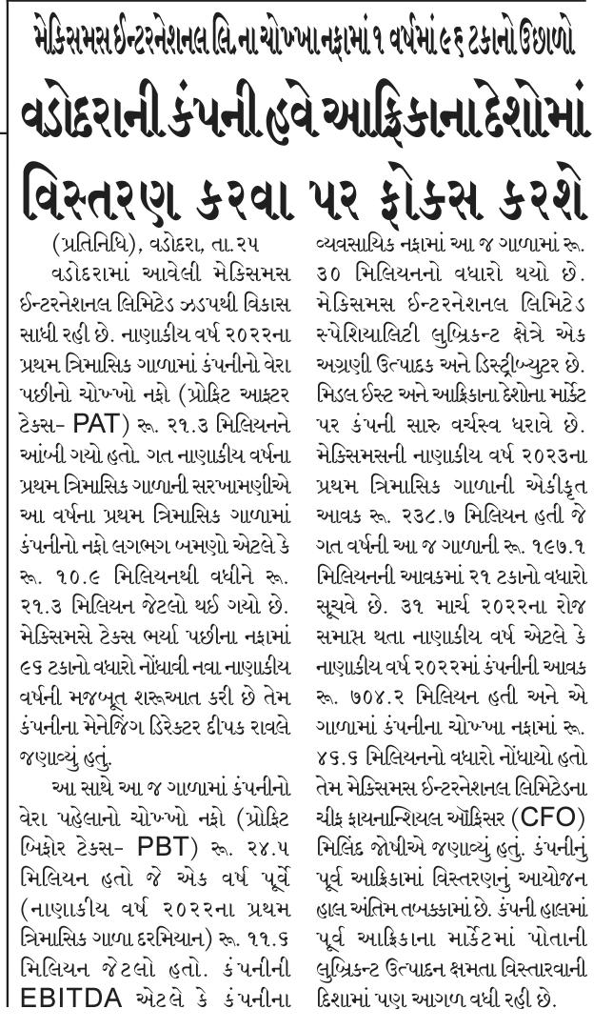
Yugprabhav Vadodara, Date :-25-8-22 Page No: 2

Slide 26
Date :-24-8-22, page no.4

Slide 27
Western Times, Date:- 26-8-22, page no. 04

Slide 28
Gujarat Vaibhav, Date:- 29-8-22, page no. 03

Slide 29
Akila - Rajkot, Date:- 29-8-22, page no. 2

Slide 30
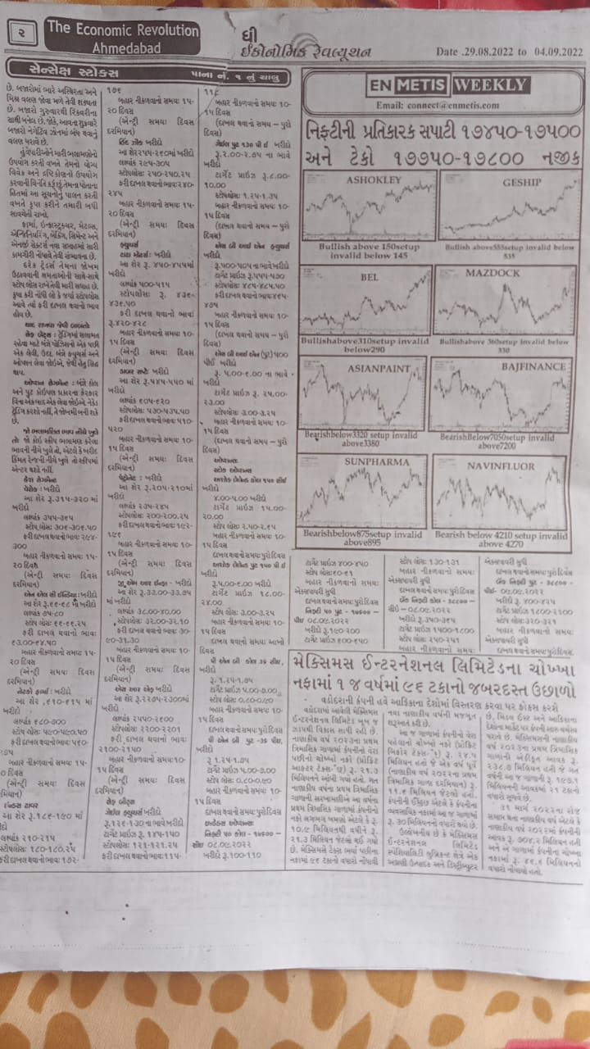
The Economic Revolution (Guj) Ahmedabad, Date 29-8-22 , page no.02

Slide 31
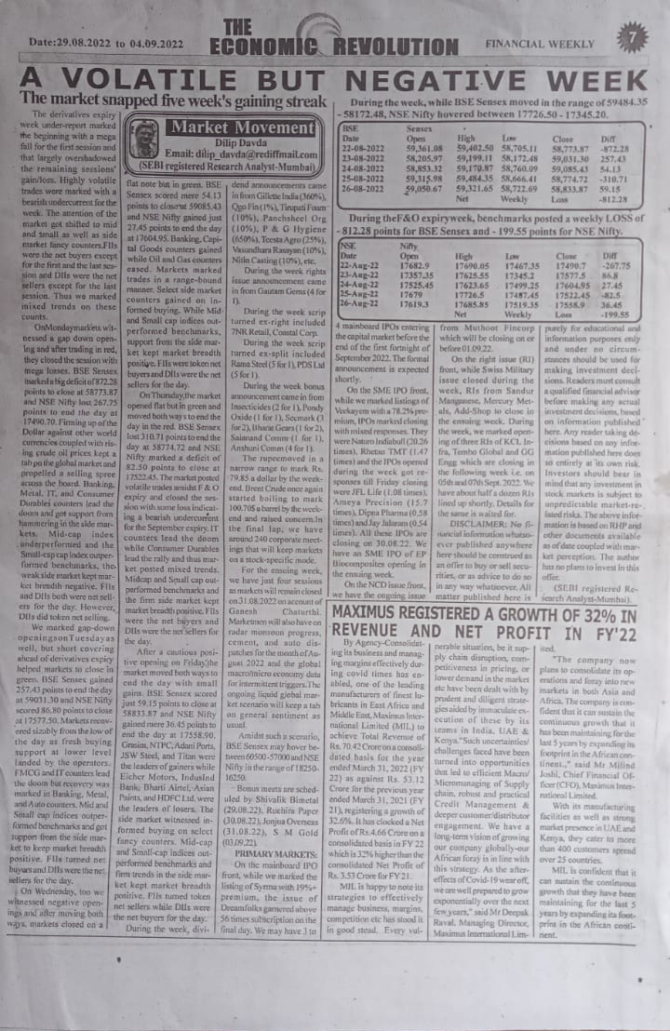
The Economic Revolution (Eng) Ahmedabad, Date:-29-8-22 page no.7

Slide 32
Smart Investment (Eng) Ahmedabad, Date :-28-8-22, page no.10

Slide 33
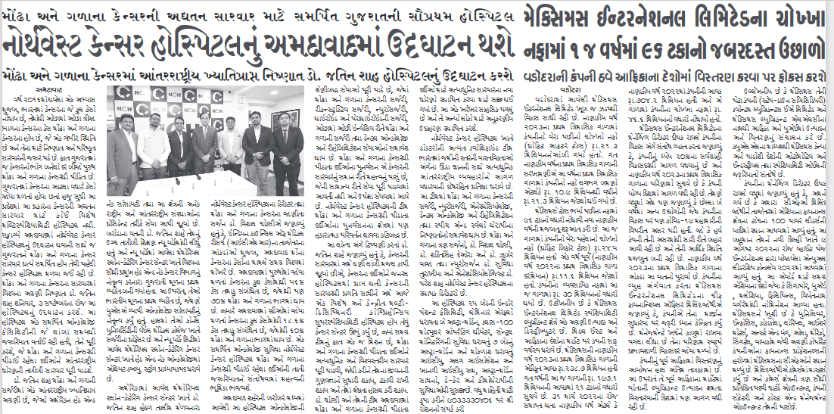
Aajkaal (Guj) :-Ahmedabad Date :-2-9-22 page no. 03

Slide 34
SMART_INVESTMENTS_GUJARATI, Date :-29-8-22 page no. 12

Slide 35
Nirmal Metro , Date :-04-9-22 page no. 03

Slide 36
Other Links:

Slide 37
https://worldbfn.com/prnw/?rkey=20220819EN49776&filter=23778 http://windowtonews.com/pr-newswire-english.php?rkey=20220819EN49776&filter=19687
https://news.webindia123.com/news/press_showdetailsPR.asp?id=1271778&cat=PR%20News%20Wire
https://www.varindia.com/news/press--pr-news-wire?rkey=20220819EN49776&filter=537 https://uttarakhandnewsnetwork.com/press-release-pr-news-wire/?rkey=20220819EN49776&filter=14497 https://www.tripuraindia.in/press-release?rkey=20220819EN49776&filter=18753 https://www.tmcnet.com/usubmit/2022/08/19/9659270.htm
http://timestech.in/trends-forecast/?rkey=20220819EN49776&filter=15939 https://www.thinkingtech.in/pr-newswire/?rkey=20220819EN49776&filter=17106
https://www.thetechoutlook.com/press-release/mils-pat-q1-fy-23-up-96-pc-plans-multi-fold-expansion-in-africa/

Slide 38
https://theindiabizz.com/pr-newswire/?rkey=20220819EN49776&filter=22970
https://the-good.in/pr-newswire/?rkey=20220819EN49776&filter=22019
https://thetechshield.com/pr-newswire/?rkey=20220819EN49776&filter=23184
https://thetechportal.com/press-releases-pr-newswire/?rkey=20220819EN49776&filter=1985
http://www.thereportingtoday.com/newswire/?rkey=20220819EN49776&filter=20784
http://thenewswatch.co.in/wp/pr-newswire/?rkey=20220819EN49776&filter=20254
https://thecrypto9.com/prnw/?rkey=20220819EN49776&filter=23534
https://thebizzstories.com/prnewswire?rkey=20220819EN49776&filter=23904
https://startupreporter.in/breaking-news/pressreleases/?rkey=20220819EN49776&filter=21583
https://startagist.com/pr-newswirelatest-tech-news-updates/?rkey=20220819EN49776&filter=20995
https://startagist.com/pr-newswire/?rkey=20220819EN49776&filter=20995

Slide 39
https://spoindia.org/press-pr-newswire/?rkey=20220819EN49776&filter=20001
https://www.sptimes.in/p/prnewswire.html?rkey=20220819EN49776&filter=23469
https://www.socialnews.xyz/pr-newswire/?rkey=20220819EN49776&filter=15405
https://smestreet.in/infocus/prnewswireindia/?rkey=20220819EN49776&filter=15935
https://www.sangritoday.com/spotlight/prnewswire?rkey=20220819EN49776&filter=22762
https://en.sangritimes.com/prnewswire?rkey=20220819EN49776&filter=21009
https://sambadenglish.com/prnews/?rkey=20220819EN49776&filter=4968
https://reviewstreet.in/news-reviews-mobiles-gadgets-pcs-automobile/prnewswireindia/?rkey=20220819EN49776&filter=15937
https://englishnews.reporterstoday.com/pr-newswire/?rkey=20220819EN49776&filter=20068
https://reportstory.com/pr-newswire/?start=314&filter=19806
https://reportodisha.com/press-releases/?rkey=20220819EN49776&filter=19014

Slide 40
https://readbox.in/pr-newswire/?rkey=20220819EN49776&filter=22117
https://www.rajasthanhorizon.com/p/prnewswire.html?rkey=20220819EN49776&filter=23459
http://www.prativad.com/Newswireeng.php?rkey=20220819EN49776&filter=19411
https://perfectnews.live/prnewswire/?rkey=20220819EN49776&filter=21266
https://parentingbharat.com/pr-newswire/?rkey=20220819EN49776&filter=24454
http://www.onenewspage.com/prnewswire.php?rkey=20220819EN49776&filter=3968
http://odisharay.com/pressreleases.php?rkey=20220819EN49776&filter=20944
http://odishanewstune.com/press-releases/?rkey=20220819EN49776&filter=19427
http://www.odishabytes.com/pr-newswire/?rkey=20220819EN49776&filter=18897
https://odishabarta.com/press-release/?rkey=20220819EN49776&filter=20444
https://nrinews24x7.com/pr-news/?rkey=20220819EN49776&filter=4972
https://www.newznew.com/press-releases/?rkey=20220819EN49776&filter=16908

Slide 41
http://www.newsr.in/prnewswire.php?rkey=20220819EN49776&filter=5070
http://www.newscontrolroom.com/pr-newswire/?rkey=20220819EN49776&filter=19537
https://www.newsblare.com/pr-newswire/?rkey=20220819EN49776&filter=20902
http://media.newswire.ca/newssuperfastblog.html?rkey=20220819EN49776&filter=10033
https://newsdeck.in/pressreleases/?rkey=20220819EN49776&filter=22015
https://newschronicle.in/pr-newswire/?rkey=20220819EN49776&filter=20256
https://www.newdelhitimes.com/news-release/?rkey=20220819EN49776&filter=5147
http://nasheman.in/newswire/?rkey=20220819EN49776&filter=11016
https://mybrandbook.co.in/redirect.php?p=11431&rkey=20220819EN49776&filter=19999
https://mybrandbook.co.in/redirect.php/?rkey=20220819EN49776&filter=19999
https://en.marudharabharti.com/p/prnewswire.html?rkey=20220819EN49776&filter=23205
https://market.theindiabizz.com/pr-newswire/?rkey=20220819EN49776&filter=23663

Slide 42
http://www.mangalorean.com/pr-newswire/?rkey=20220819EN49776&filter=17665
https://livechronicle.in/pr-newswire/?rkey=20220819EN49776&filter=22011
http://www.hydnews.net/pr-newswire?rkey=20220819EN49776&filter=20977
https://en.jalorelive.com/p/prnewswire.html?rkey=20220819EN49776&filter=23504
https://www.iqstock.news/n/mil-pat-q1-fy-23-96-pc-plans-multi-fold-expansion-africa-4412243/
https://invested.one/prnw/?rkey=20220819EN49776&filter=23780
https://inumarket.org/prnw/?rkey=20220819EN49776&filter=23773
https://english.instanews24x7.com/press-releases?rkey=20220819EN49776&filter=20045
https://insightonlinenews.in/english-press-release/?rkey=20220819EN49776&filter=20283
http://indoredilse.com/english-news/?rkey=20220819EN49776&filter=10474
https://indianspectator.com/prnewswire/?rkey=20220819EN49776&filter=21881
http://indianpowersector.com/prnews/?rkey=20220819EN49776&filter=4997

Slide 43
http://indiannerve.com/in-press/?rkey=20220819EN49776&filter=6492
http://indiancatwalk.com/press-release/?rkey=20220819EN49776&filter=22868
https://www.indiatoday.in/pr-newswire?rkey=20220819EN49776&filter=4315
http://news.indiaonline.in/prnewswire?rkey=20220819EN49776&filter=4991
http://www.indiainfoline.com/prnewswire?rkey=20220819EN49776&filter=4993
https://imp.news/prnw/?rkey=20220819EN49776&filter=23444
https://ibtn9.com/pr-newswire/?rkey=20220819EN49776&filter=12202
https://ibgnews.com/pr-newswire-news/?rkey=20220819EN49776&filter=19585
http://www.hellomumbainews.com/hello-business/?rkey=20220819EN49776&filter=12313
https://en.hamarasamachar.in/p/prnewswire.html?rkey=20220819EN49776&filter=23471
https://groundreport.in/pr-news-english-2/?rkey=20220819EN49776&filter=20940
https://goodreport.in/pr-newswire/?rkey=20220819EN49776&filter=22013

Slide 44
https://goearth.in/pr-newswire/?rkey=20220819EN49776&filter=20252
https://globalprimenews.com/prnewswire/?rkey=20220819EN49776&filter=19416
https://fincorp.one/prnw/?rkey=20220819EN49776&filter=23782
https://finacialdesk.org/prnw/?rkey=20220819EN49776&filter=23770
https://www.falconnews.net/pr-newswire?rkey=20220819EN49776&filter=23363
https://enterpriseworldnews.com/pr-newswire/?rkey=20220819EN49776&filter=19539
https://earthnews4u.com/pr-newswire/?rkey=20220819EN49776&filter=20250
https://www.dkoding.in/press-release/mils-pat-q1-fy-23-up-96-pc-plans-multi-fold-expansion-in-africa/
https://digitalconqurer.com/prnewswire/technology/?rkey=20220819EN49776&filter=3833
https://deccaninsider.org/prnw/?rkey=20220819EN49776&filter=23776
http://crweworld.com/article/news-provided-by-pr-newswire/2475861/mils-pat-q1-fy-23-up-96-pc-plans-multi-fold-expansion-in-africa

Slide 45
https://crackofdawn.in/press-release/?rkey=20220819EN49776&filter=20900
http://businessviews.in/business-views-press-release-news/?rkey=20220819EN49776&filter=908
https://www.businessupturn.com/brand-post/mils-pat-q1-fy-23-up-96-pc-plans-multi-fold-expansion-in-africa/
http://www.businesstoday.in/prnewswire/?rkey=20220819EN49776&filter=2418
http://www.businesssandesh.in/breaking-news/?rkey=20220819EN49776&filter=7621
http://businessnewsthisweek.com/prnews/?rkey=20220819EN49776&filter=601
http://www.biznextindia.com/pr-newswire/?rkey=20220819EN49776&filter=19403
http://www.bizwireexpress.com/showstoryPRN.php?rkey=20220819EN49776&filter=2276
https://bitworld.one/prnw/?rkey=20220819EN49776&filter=23775
http://news.biharprabha.com/prnewswire/?rkey=20220819EN49776&filter=2270
http://www.bangalorewaves.com/news/bangalorewaves-business-news.php?rkey=20220819EN49776&filter=2267

Slide 46
https://atcrypto.org/prnw/?rkey=20220819EN49776&filter=23535
http://www.asianbuck.com/asianbuck-prnews/?rkey=20220819EN49776&filter=8421
http://asiamanufacturingnewstoday.com/newswire/?rkey=20220819EN49776&filter=22061
https://www.agrnews.in/p/prnewswire.html?rkey=20220819EN49776&filter=23473
http://www.abhitaknews.com/english/news/press-releases.aspx?rkey=20220819EN49776&filter=1889
http://www.5dariyanews.com/Full-Story-Latest-from-PR-Newswire.aspx?rkey=20220819EN49776&filter=3325

