Slide 1
Maximus Press Release

Slide 2
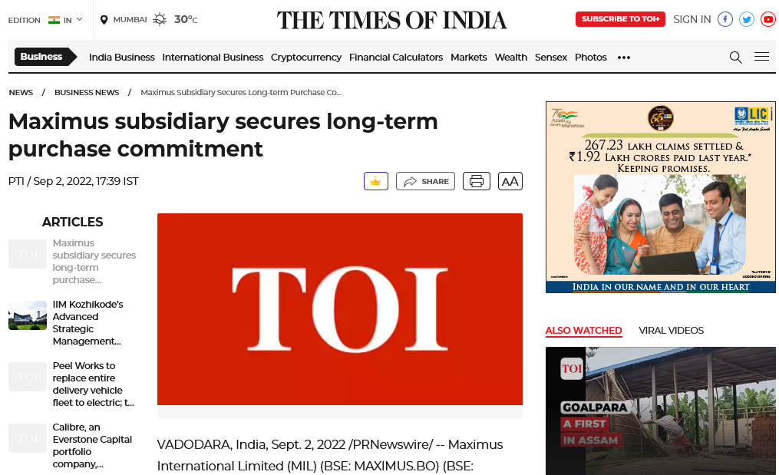
https://timesofindia.indiatimes.com/maximus-subsidiary-secures-long-term-purchase-commitment/articleshow/93951839.cms

Slide 3
Business Standard Ahmedabad, Date :-09-9-22 Page No: 22

Slide 4
Business Standard Mumbai, Date :-09-9-22 Page No: 22

Slide 5
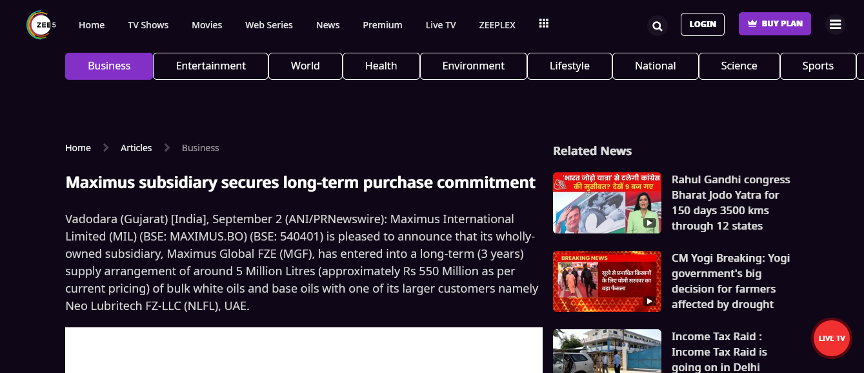
https://www.zee5.com/articles/maximus-subsidiary-secures-long-term-purchase-commitment

Slide 6
Al jazeera: https://aljazeera.co.in/politics/maximus-subsidiary-secures-long-term-purchase-commitment/

Slide 7
Sandesh, Date :-06-9-22 Page No:2

Slide 8
Divya Bhaskar - Ahmedabad, Date :-06-9-22 Page No:2

Slide 9
Divya Bhaskar - Surat, Date :-06-9-22 Page No:2

Slide 10
Divya Bhaskar - Rajkot, Date :-06-9-22 Page No:2

Slide 11
Divya Bhaskar - Mumbai, Date :-06-9-22 Page No:2

Slide 12
Yugprabhav Vadodara, Date :-05-9-22 Page No:2

Slide 13
Suryakal, Date :-06-9-22 Page No:02

Slide 14
ફૂલછાબ Phulchhab, Date :-04-9-22 Page No: 8

Slide 15
Loksatta Jansatta -surat, Date :-04-9-22 Page No:9

Slide 16
Vadodara Samachar, Date :-04-9-22 Page No:3

Slide 17
Jai Hind, Date :-04-9-22 Page No:9

Slide 18
Prabhat, Date :-04-9-22 Page No:3

Slide 19
Sr. Herald, Date :-04-9-22 Page No:7

Slide 20
Rakhewal, Date :-04-9-22 Page No:2

Slide 21
Nav Gujrat Samay, Date :-07-9-22 Page No:04

Slide 22
Western Times, Date :-08-9-22 Page No:04

Slide 23
Kesari, Date :-08-9-22 Page No:04

Slide 24
Gujarat Vaibhav, Date :-08-9-22 Page No:11

Slide 25
Akila Rajkot City, Date :-08-9-22 Page No:06

Slide 26
Akila Rajkot City, Date :-08-9-22 Page No:06

Slide 27
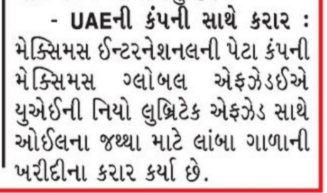
Gujrat Samachar Vadodara, Date :-08-9-22 Page No:06

Slide 28
Free press (Eng) Ahmedabad Date:- 9-9-22 page no .02

Slide 29
The Economic Revolution (Eng) :-Ahmedabad Date:-12-9-22 page no 04,

Slide 30
The Economic Revolution (Guj) Ahmedabad, Date:-12-9-22, page no .04

Slide 31
Smart Investment (Eng) Ahmedabad, Date:-11-9-22 page no 04

Slide 32
Smart Investment (Guj) Ahmedabad, Date:-12-9-22, Page no 06

Slide 33
Loksatta Jansatta, Date:-19-9-22, Page no 09

Slide 34
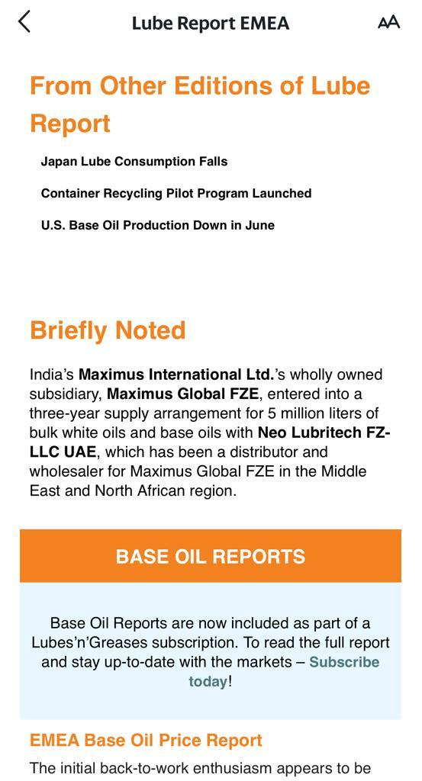
Lube Report EMEA

Slide 35
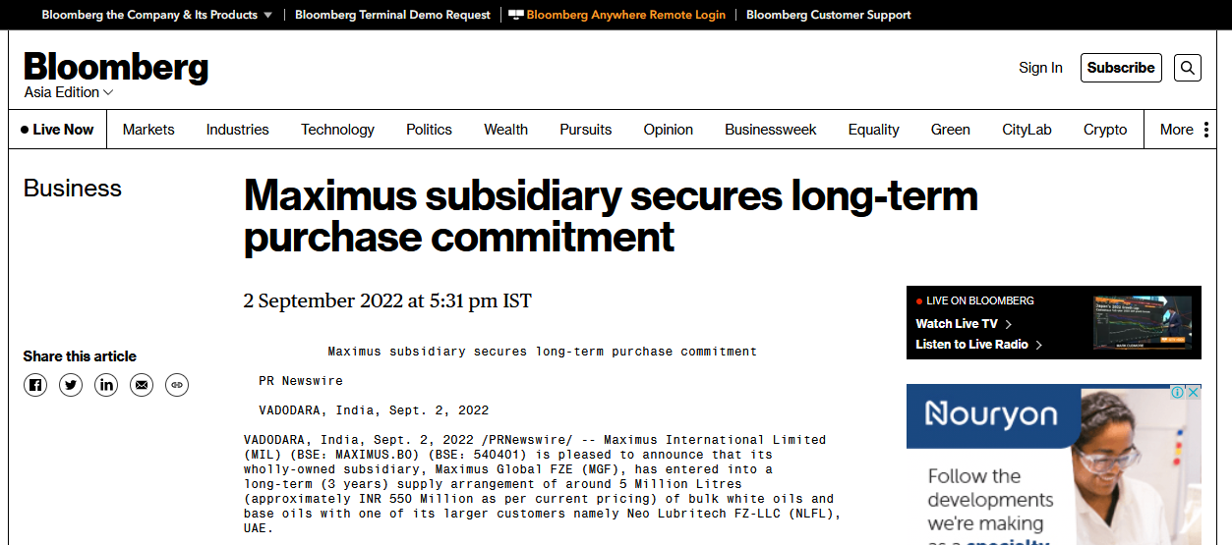
https://www.bloomberg.com/press-releases/2022-09-02/maximus-subsidiary-secures-long-term-purchase-commitment

Slide 36
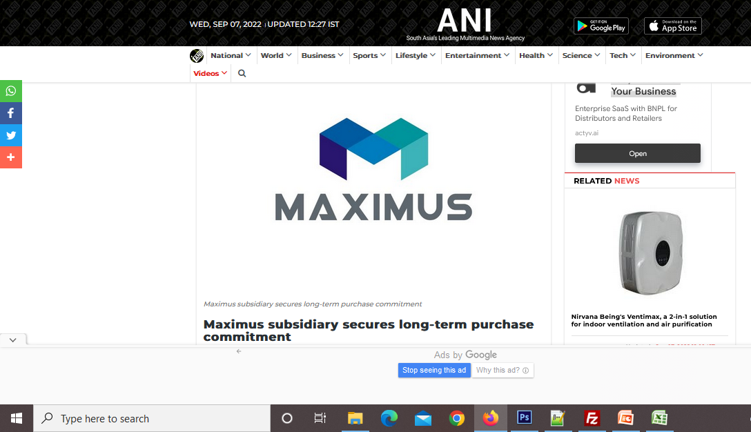
https://www.aninews.in/news/business/business/maximus-subsidiary-secures-long-term-purchase-commitment20220902191551/

Slide 37
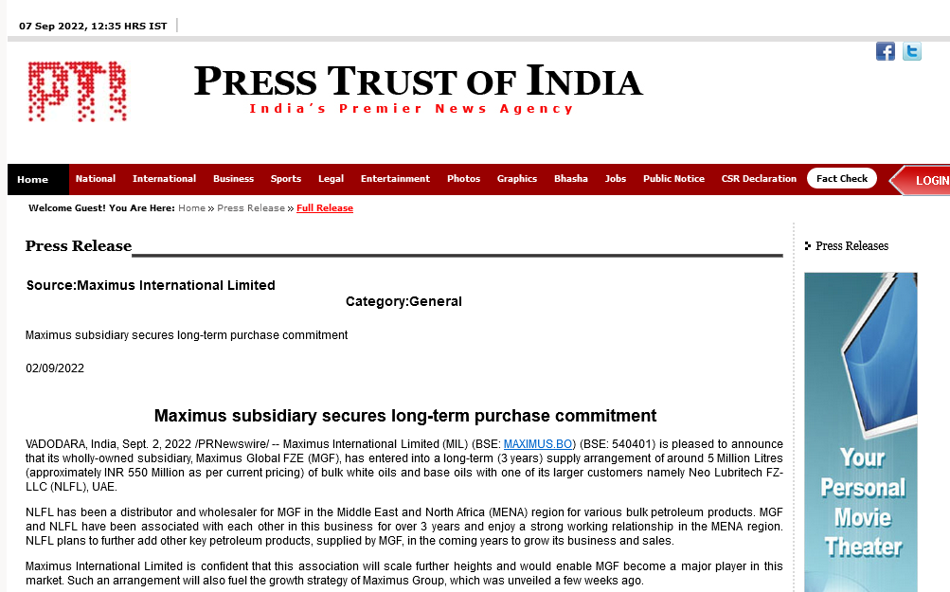
http://www.ptinews.com/pressrelease/57103_press-subMaximus-subsidiary-secures-long-term-purchase-commitment

Slide 38
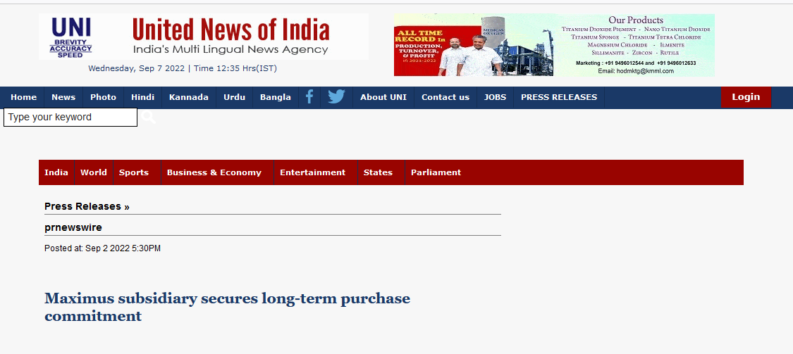
http://www.uniindia.com/maximus-subsidiary-secures-long-term-purchase-commitment/prnewswire/news/2814154.html

Slide 39
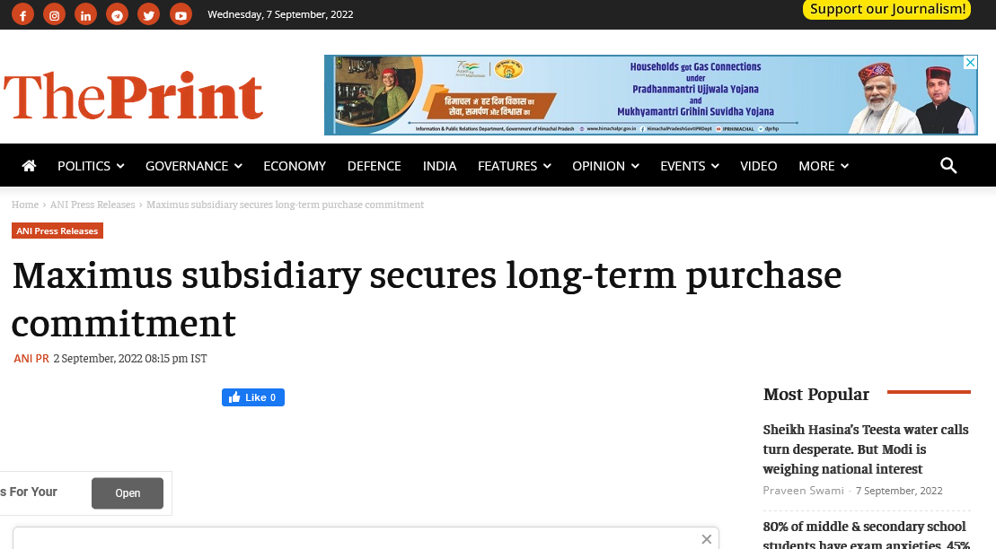
https://theprint.in/ani-press-releases/maximus-subsidiary-secures-long-term-purchase-commitment-2/1113879/

Slide 40
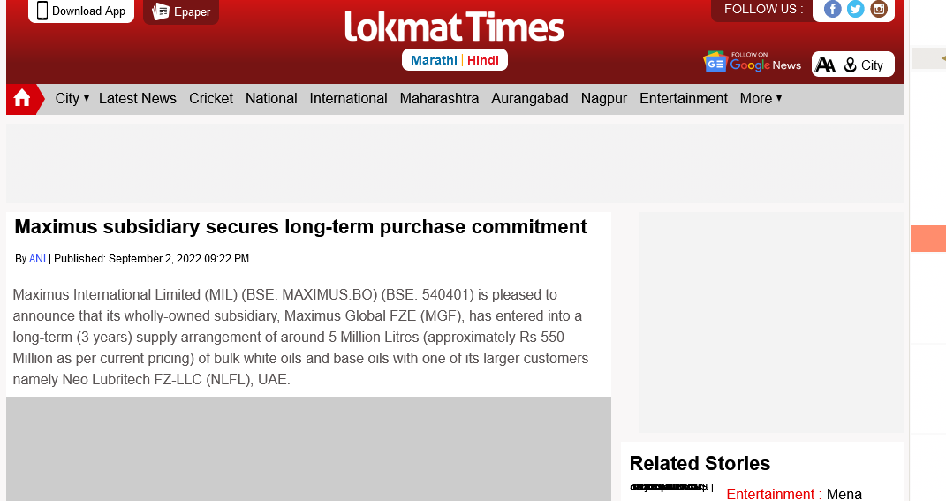
https://www.lokmattimes.com/business/maximus-subsidiary-secures-long-term-purchase-commitment/

Slide 41
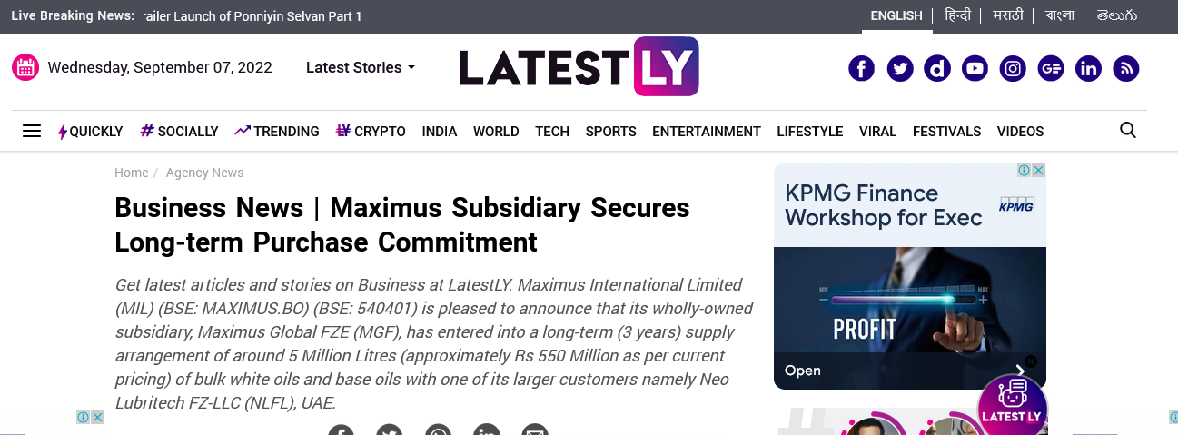
https://www.latestly.com/agency-news/business-news-maximus-subsidiary-secures-long-term-purchase-commitment-4158708.html

Slide 42
https://businessfortnight.com/maximus-subsidiary-secures-long-term-purchase-commitment/
https://www.britishcolumbiatimes.com/news/maximus-subsidiary-secures-long-term-purchase-commitment20220902191545/
https://www.tnewsdesk.com/business-news-maximus-subsidiary-secures-long-term-purchase-commitment/
https://www.australiamorningtribune.com/news/maximus-subsidiary-secures-long-term-purchase-commitment20220902191545/
https://www.dubaicityreporter.com/
https://www.maldivesstarplus.com/news/maximus-subsidiary-secures-long-term-purchase-commitment20220902191545/
https://indiashorts.com/maximus-subsidiary-secures-long-term-purchase-commitment/86480/
https://www.japantimestoday.com/news/maximus-subsidiary-secures-long-term-purchase-commitment20220902212211/

Slide 43
https://worldbfn.com/prnw/?rkey=20220902EN62056&filter=23778
http://windowtonews.com/pr-newswire-english.php?rkey=20220902EN62056&filter=19687
https://news.webindia123.com/news/press_showdetailsPR.asp?id=1274264&cat=PR%20News%20Wire
https://news.webindia123.com/news/press_showdetailsPR.asp?id=1274116&cat=PR%20News%20Wire
https://news.webindia123.com/news/press_showdetailsPR.asp?id=1273956&cat=PR%20News%20Wire
https://news.webindia123.com/news/press_showdetailsPR.asp?id=1273771&cat=PR%20News%20Wire
https://uttarakhandnewsnetwork.com/press-release-pr-news-wire/?rkey=20220902EN62056&filter=14497
https://www.tripuraindia.in/press-release?rkey=20220902EN62056&filter=18753
https://theindiabizz.com/pr-newswire/?rkey=20220902EN62056&filter=22970

Slide 44
https://the-good.in/pr-newswire/?rkey=20220902EN62056&filter=22019
http://www.thereportingtoday.com/newswire/?rkey=20220902EN62056&filter=20784
http://thenewswatch.co.in/wp/pr-newswire/?rkey=20220902EN62056&filter=20254
https://spoindia.org/press-pr-newswire/?rkey=20220902EN62056&filter=20001
https://www.sptimes.in/p/prnewswire.html?rkey=20220902EN62056&filter=23469
https://www.socialnews.xyz/pr-newswire/?rkey=20220902EN62056&filter=15405
https://smestreet.in/infocus/prnewswireindia/?rkey=20220902EN62056&filter=15935
https://www.sangritoday.com/spotlight/prnewswire?rkey=20220902EN62056&filter=22762
https://en.sangritimes.com/prnewswire?rkey=20220902EN62056&filter=21009
https://sambadenglish.com/prnews/?rkey=20220902EN62056&filter=4968
https://reviewstreet.in/news-reviews-mobiles-gadgets-pcs-automobile/prnewswireindia/?rkey=20220902EN62056&filter=15937

Slide 45
https://englishnews.reporterstoday.com/pr-newswire/?rkey=20220902EN62056&filter=20068
https://reportstory.com/pr-newswire/?start=316&filter=19806
https://reportstory.com/pr-newswire/?start=3&filter=19806
https://reportstory.com/pr-newswire/?rkey=20220902EN62056&filter=19806
https://reportodisha.com/press-releases/?rkey=20220902EN62056&filter=19014
https://readbox.in/pr-newswire/?rkey=20220902EN62056&filter=22117
https://www.rajasthanhorizon.com/p/prnewswire.html?rkey=20220902EN62056&filter=23459
http://www.ptinews.com/pressrelease/57103_press-submaximus-subsidiary-secures-long-term-purchase-commitment
http://www.prativad.com/Newswireeng.php?rkey=20220902EN62056&filter=19411
https://www.prnewswire.com/in/news-releases/maximus-subsidiary-secures-long-term-purchase-commitment-848590449.html

Slide 46
https://perfectnews.live/prnewswire/?rkey=20220902EN62056&filter=21266
https://parentingbharat.com/pr-newswire/?rkey=20220902EN62056&filter=24454
http://www.onenewspage.com/prnewswire.php?rkey=20220902EN62056&filter=3968
http://odisharay.com/pressreleases.php?rkey=20220902EN62056&filter=20944
https://odishanewstune.com/press-releases/?rkey=20220902EN62056&filter=19427
http://www.odishabytes.com/pr-newswire/?rkey=20220902EN62056&filter=18897
https://odishabarta.com/press-release/?rkey=20220902EN62056&filter=20444
https://nrinews24x7.com/pr-news/?rkey=20220902EN62056&filter=4972
https://www.newznew.com/press-releases/?rkey=20220902EN62056&filter=16908
http://www.newsr.in/prnewswire.php?rkey=20220902EN62056&filter=5070
http://www.newscontrolroom.com/pr-newswire/?rkey=20220902EN62056&filter=19537
https://www.newsblare.com/pr-newswire/?rkey=20220902EN62056&filter=20902

Slide 47
http://media.newswire.ca/newssuperfastblog.html?rkey=20220902EN62056&filter=10033
https://newsdeck.in/pressreleases/?rkey=20220902EN62056&filter=22015
https://newschronicle.in/pr-newswire/?rkey=20220902EN62056&filter=20256
https://www.newdelhitimes.com/news-release/?rkey=20220902EN62056&filter=5147
http://nasheman.in/newswire/?rkey=20220902EN62056&filter=11016
https://en.marudharabharti.com/p/prnewswire.html?rkey=20220902EN62056&filter=23205
https://market.theindiabizz.com/pr-newswire/?rkey=20220902EN62056&filter=23663
https://www.manifoldtimes.com/pr-newswire/?rkey=20220902EN62056&filter=20785
http://www.mangalorean.com/pr-newswire/?rkey=20220902EN62056&filter=17665
https://livechronicle.in/pr-newswire/?rkey=20220902EN62056&filter=22011
https://lifeandtrendz.com/news/prnewswire/?rkey=20220902EN62056&amp;filter=22944
http://www.lang1234.info/prnewswire.html/?rkey=20220902EN62056&filter=10756

Slide 48
http://www.hydnews.net/pr-newswire?rkey=20220902EN62056&filter=20977
https://en.jalorelive.com/p/prnewswire.html?rkey=20220902EN62056&filter=23504
https://www.iqstock.news/n/maximus-subsidiary-secures-long-term-purchase-commitment-4483208/
https://invested.one/prnw/?rkey=20220902EN62056&filter=23780
https://english.instanews24x7.com/press-releases?rkey=20220902EN62056&filter=20045
https://insightonlinenews.in/english-press-release/?rkey=20220902EN62056&filter=20283
http://indoredilse.com/english-news/?rkey=20220902EN62056&filter=10474
https://indianspectator.com/prnewswire/?rkey=20220902EN62056&filter=21881
http://indianpowersector.com/prnews/?rkey=20220902EN62056&filter=4997
http://indiannerve.com/in-press/?rkey=20220902EN62056&filter=6492
https://www.indiatoday.in/pr-newswire?rkey=20220902EN62056&filter=4315

Slide 49
http://news.indiaonline.in/prnewswire?rkey=20220902EN62056&filter=4991
http://www.indiainfoline.com/prnewswire?rkey=20220902EN62056&filter=4993
https://imp.news/prnw/?rkey=20220902EN62056&filter=23444
https://ibtn9.com/pr-newswire/?rkey=20220902EN62056&filter=12202
https://ibgnews.com/pr-newswire-news/?rkey=20220902EN62056&filter=19585
http://www.hellomumbainews.com/hello-business/?rkey=20220902EN62056&filter=12313
https://en.hamarasamachar.in/p/prnewswire.html?rkey=20220902EN62056&filter=23471
https://groundreport.in/pr-news-english-2/?rkey=20220902EN62056&filter=20940
https://goodreport.in/pr-newswire/?rkey=20220902EN62056&filter=22013
https://goearth.in/pr-newswire/?rkey=20220902EN62056&filter=20252
https://globalprimenews.com/prnewswire/?rkey=20220902EN62056&filter=19416
https://fincorp.one/prnw/?rkey=20220902EN62056&filter=23782

Slide 50
https://www.falconnews.net/pr-newswire?rkey=20220902EN62056&filter=23363
https://earthnews4u.com/pr-newswire/?rkey=20220902EN62056&filter=20250
https://www.dkoding.in/press-release/maximus-subsidiary-secures-long-term-purchase-commitment/
https://deccaninsider.org/prnw/?rkey=20220902EN62056&filter=23776
http://crweworld.com/article/news-provided-by-pr-newswire/2487792/maximus-subsidiary-secures-long-term-purchase-commitment
https://crackofdawn.in/press-release/?rkey=20220902EN62056&filter=20900
https://www.businessupturn.com/brand-post/maximus-subsidiary-secures-long-term-purchase-commitment/
http://www.businesstoday.in/prnewswire/?rkey=20220902EN62056&filter=2418
http://www.businesssandesh.in/breaking-news/?rkey=20220902EN62056&filter=7621
http://businessnewsthisweek.com/prnews/?rkey=20220902EN62056&filter=601

Slide 51
http://www.biznextindia.com/pr-newswire/?rkey=20220902EN62056&filter=19403
http://www.bizwireexpress.com/showstoryPRN.php?rkey=20220902EN62056&filter=2276
http://news.biharprabha.com/prnewswire/?rkey=20220902EN62056&filter=2270
http://www.bangalorewaves.com/news/bangalorewaves-business-news.php/?rkey=20220902EN62056&filter=2267
http://www.asianbuck.com/asianbuck-prnews/?rkey=20220902EN62056&filter=8421
https://www.agrnews.in/p/prnewswire.html?rkey=20220902EN62056&filter=23473
http://www.abhitaknews.com/english/news/press-releases.aspx?rkey=20220902EN62056&filter=1889
http://www.5dariyanews.com/Full-Story-Latest-from-PR-Newswire.aspx?rkey=20220902EN62056&filter=3325
http://www.prnewswire.com/in/news-releases/maximus-subsidiary-secures-long-term-purchase-commitment-848590449.html

