Slide 1
Press Release

Slide 2
https://twitter.com/i/flow/login?redirect_after_login=%2Fet_infra

Slide 3
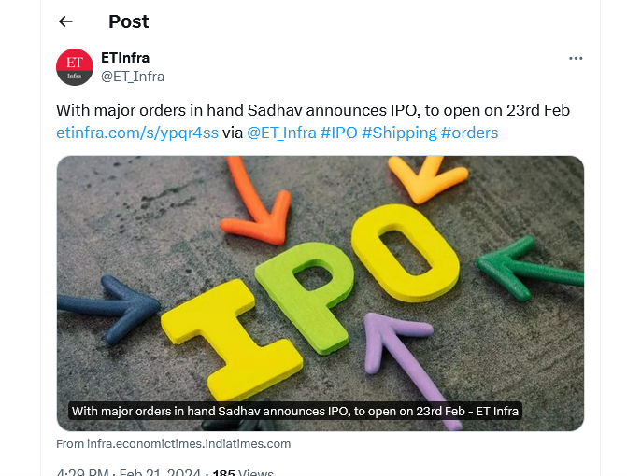
https://twitter.com/ET_Infra/status/1760257826457256250?s=20

Slide 4
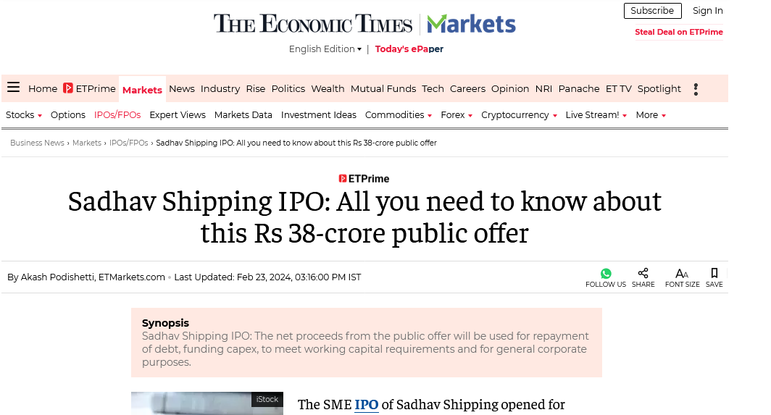
https://economictimes.indiatimes.com/markets/ipos/fpos/sadhav-shipping-ipo-all-you-need-to-know-about-this-rs-38-crore-public-offer/articleshow/107940715.cms?from=mdr

Slide 5
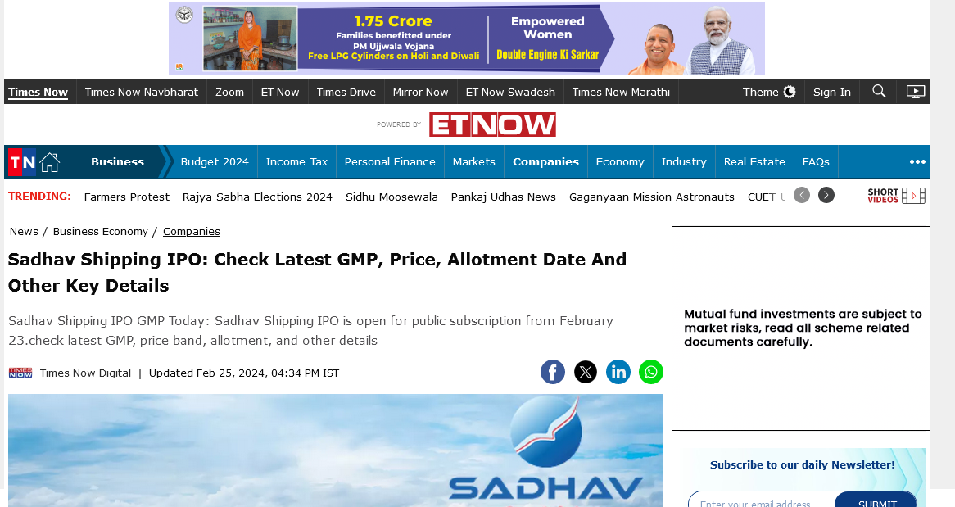
https://www.timesnownews.com/business-economy/companies/sadhav-shipping-ipo-check-latest-gmp-price-allotment-date-and-other-key-details-article-107985235

Slide 6
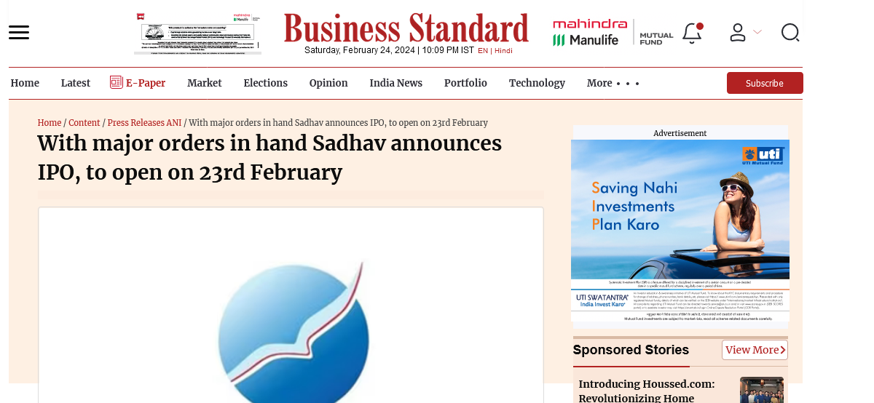
https://www.business-standard.com/content/press-releases-ani/with-major-orders-in-hand-sadhav-announces-ipo-to-open-on-23rd-february-124022000717_1.html

Slide 7
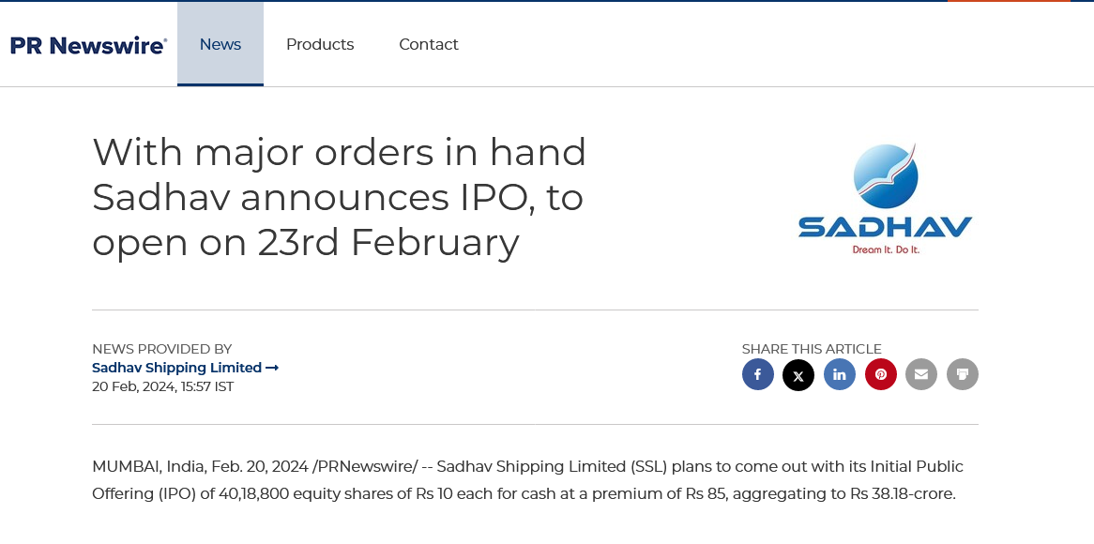
https://www.prnewswire.com/in/news-releases/with-major-orders-in-hand-sadhav-announces-ipo-to-open-on-23rd-february-302065900.html

Slide 8
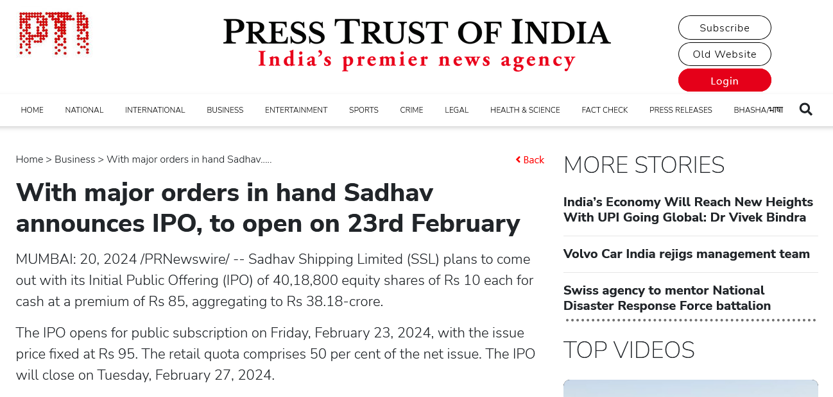
https://www.ptinews.com/story/business/with-major-orders-in-hand-sadhav-announces-ipo-to-open-on-23rd-february/1303815

Slide 9
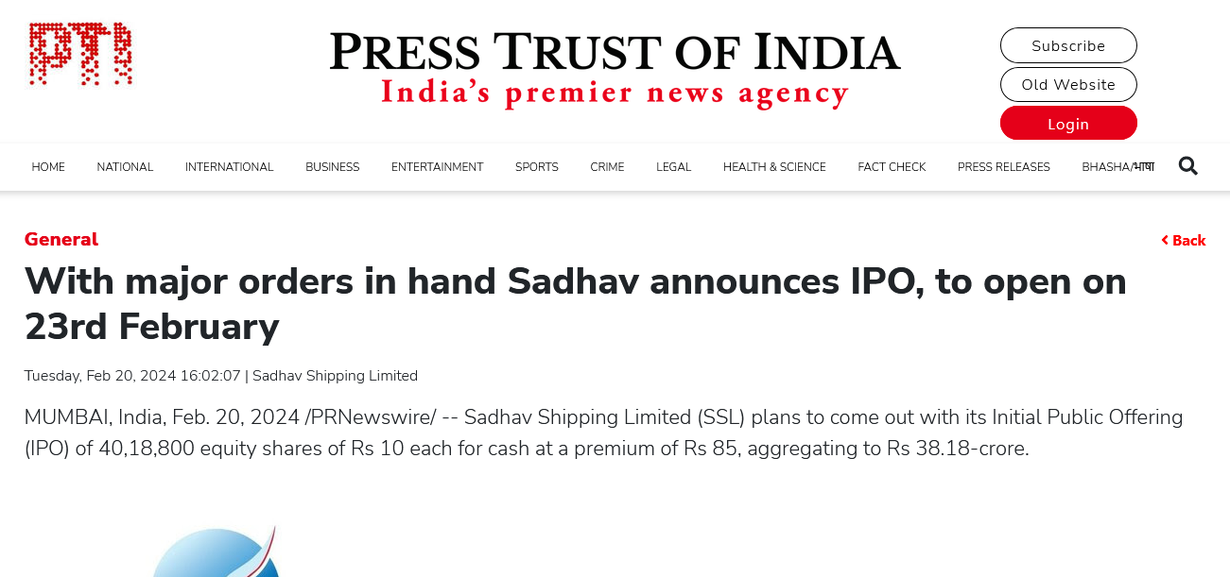
https://www.ptinews.com/press-release/with-major-orders-in-hand-sadhav-announces-ipo-to-open-on-23rd-february/1303787

Slide 10
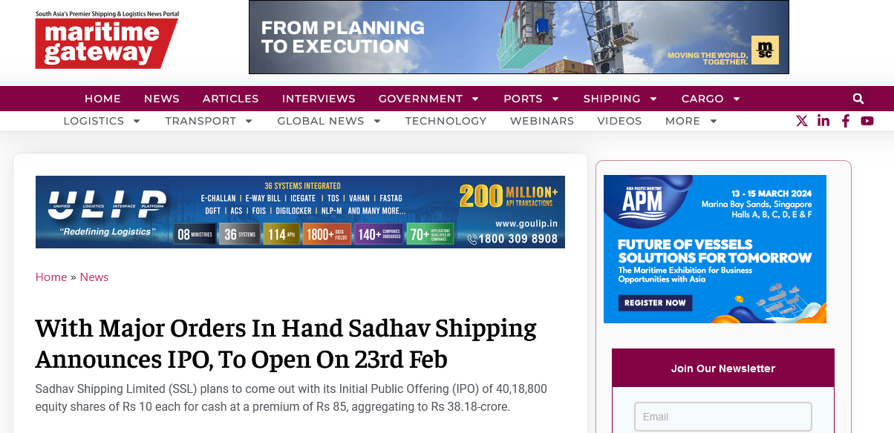
https://www.maritimegateway.com/with-major-orders-in-hand-sadhav-shipping-announces-ipo-to-open-on-23rd-feb/

Slide 11
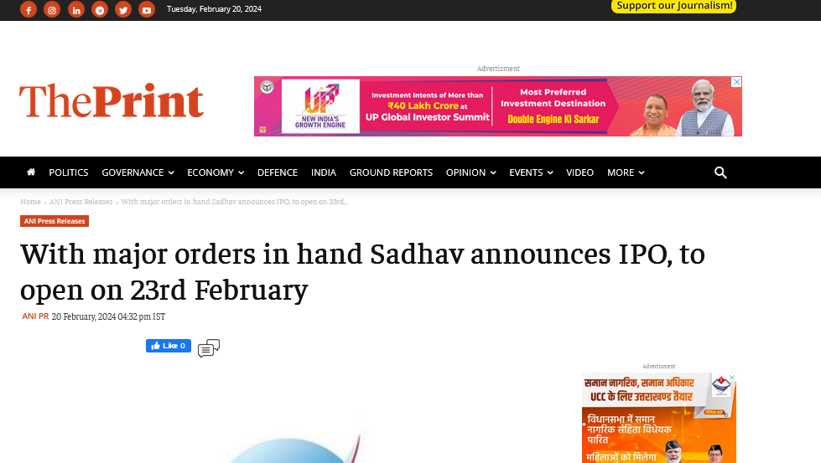
https://theprint.in/ani-press-releases/with-major-orders-in-hand-sadhav-announces-ipo-to-open-on-23rd-february/1972564/

Slide 12
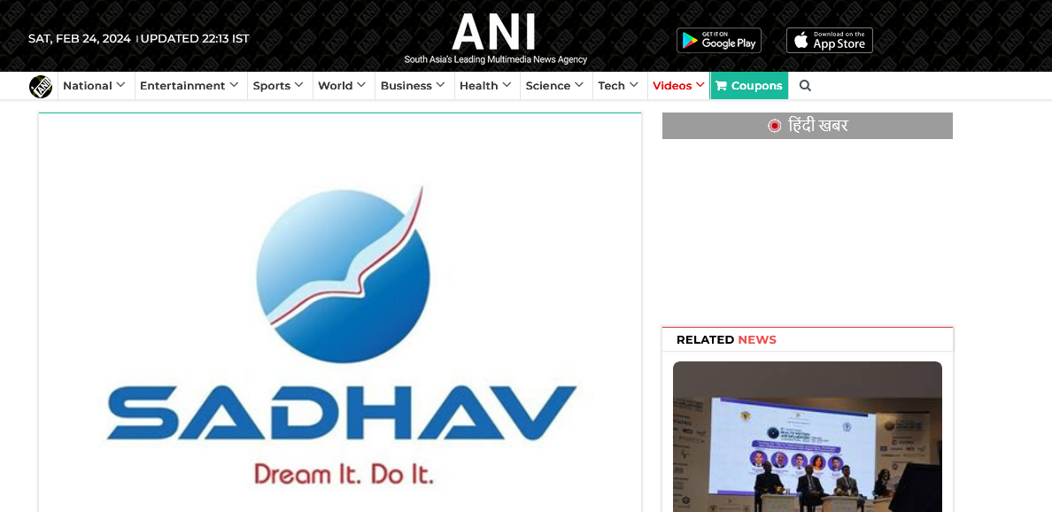
https://www.aninews.in/news/business/with-major-orders-in-hand-sadhav-announces-ipo-to-open-on-23rd-february20240220162912/

Slide 13
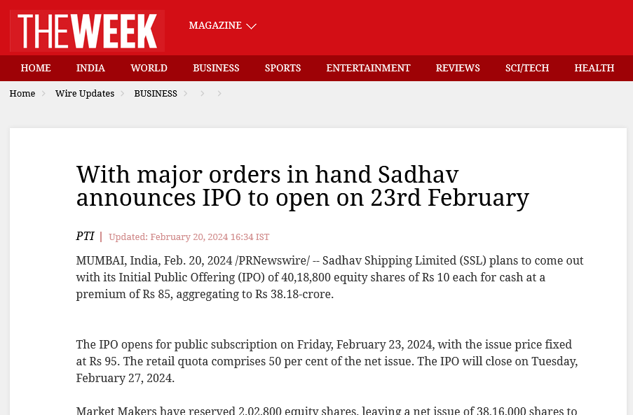
https://www.theweek.in/wire-updates/business/2024/02/20/dcm46-sadhav-shipping-limited.html

Slide 14
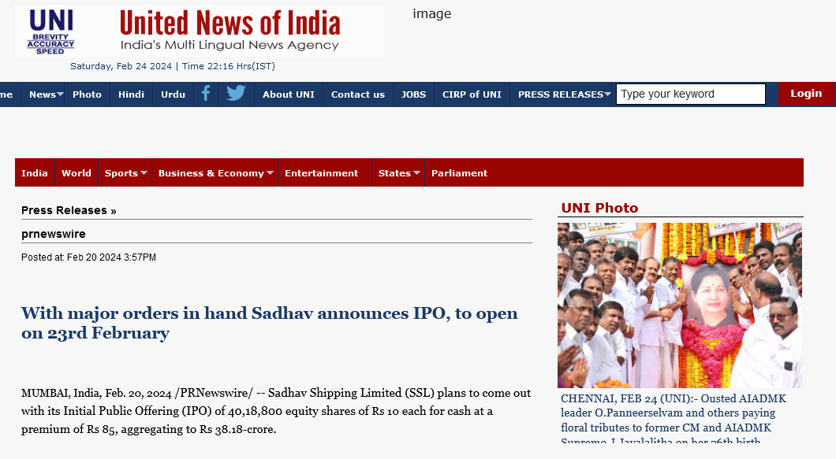
http://www.uniindia.com/with-major-orders-in-hand-sadhav-announces-ipo-to-open-on-23rd-february/prnewswire/news/3146977.html

Slide 15
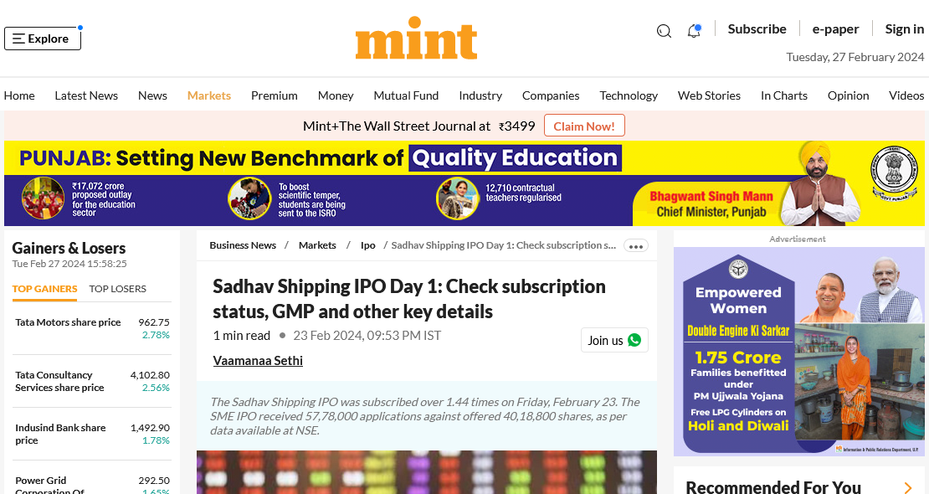
https://www.livemint.com/market/ipo/sadhav-shipping-ipo-check-subscription-status-gmp-and-other-key-details-11708696011393.html

Slide 16
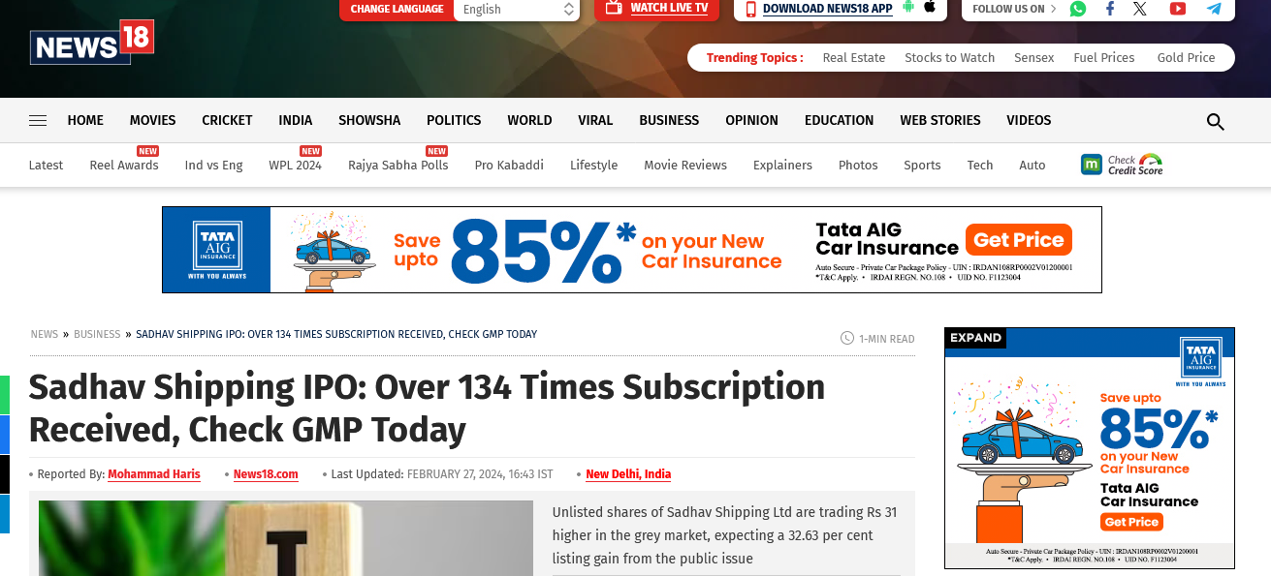
https://www.news18.com/business/sadhav-shipping-ipo-check-subscription-status-gmp-today-8794434.html

Slide 17
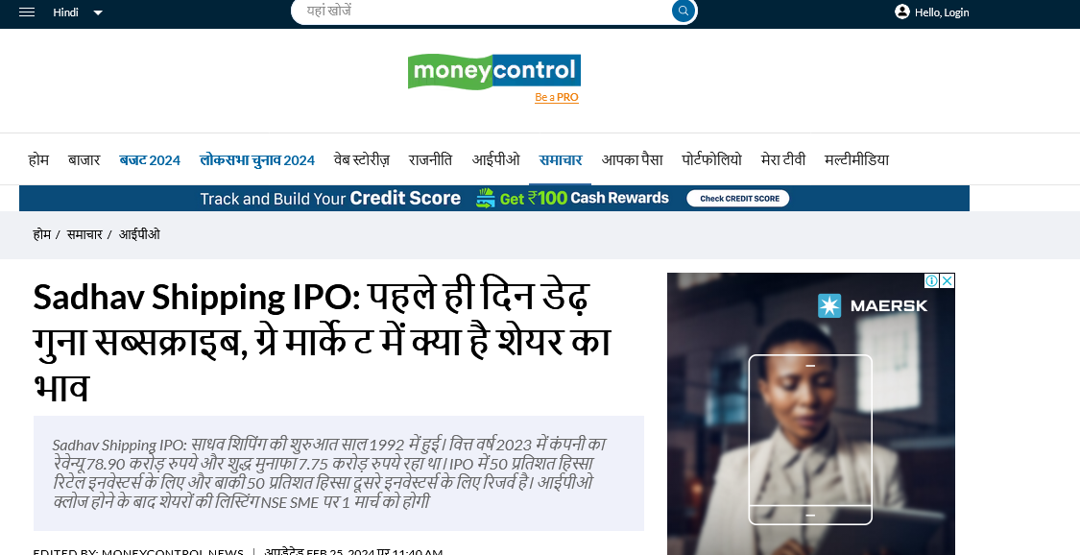
https://hindi.moneycontrol.com/news/ipo/sadhav-shipping-ipo-subscribed-one-and-a-half-times-on-day-1-know-what-grey-market-signalling-sadhav-shipping-public-issue-listing-date-1805911.html

Slide 18
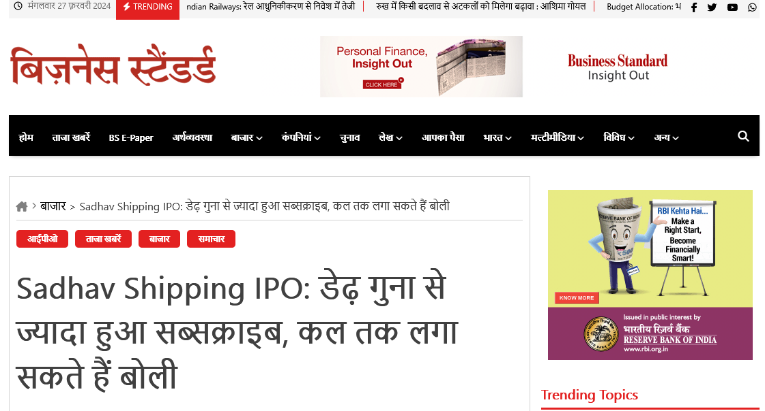
https://hindi.business-standard.com/markets/sadhav-shipping-ipo-subscribed-more-than-one-and-a-half-times-you-can-place-bids-till-tomorrow-id-344749

Slide 19
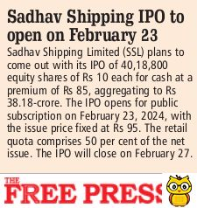
Free press journal , cat A page 11, date 21 feb

Slide 20
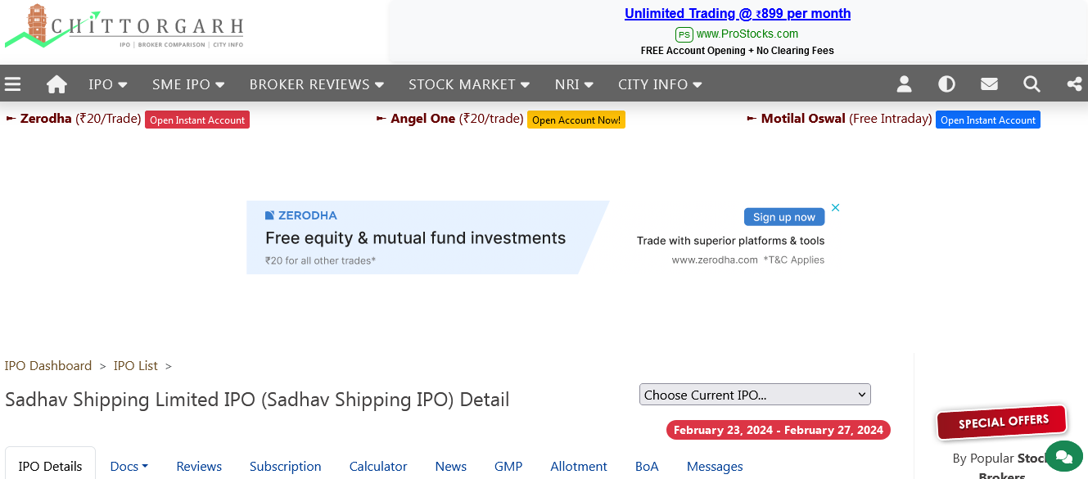
https://www.chittorgarh.com/ipo/sadhav-shipping-ipo/1657/

Slide 21
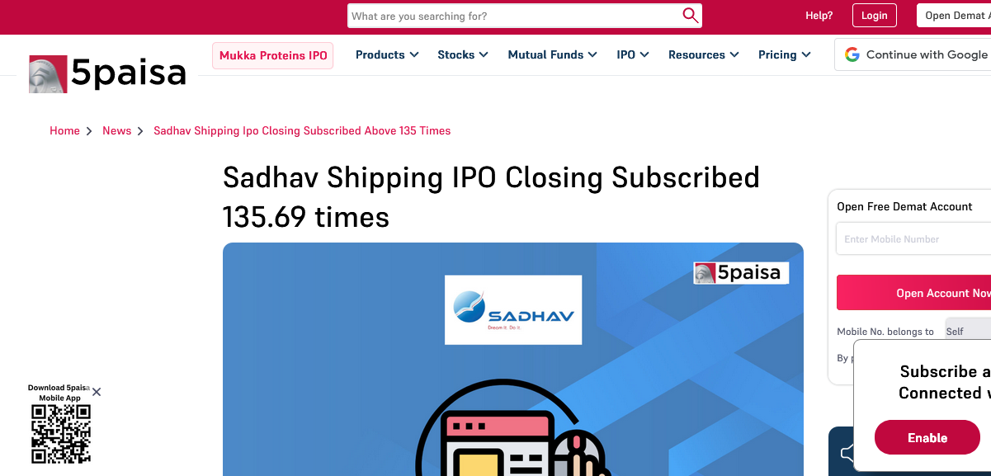
https://www.5paisa.com/news/sadhav-shipping-ipo-closing-subscribed-above-135-times

Slide 22
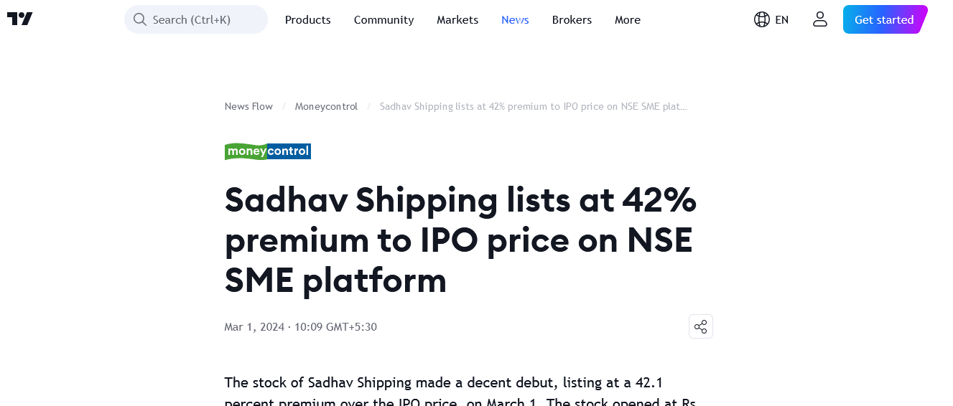
https://www.tradingview.com/news/moneycontrol:c7f3d9058094b:0-sadhav-shipping-lists-at-42-premium-to-ipo-price-on-nse-sme-platform/

Slide 23
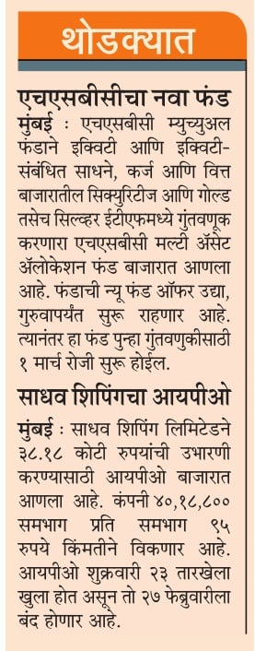
MAHARASHTRA TIMES , PAGE 11, CAT A, DATE 21 FEB

Slide 24
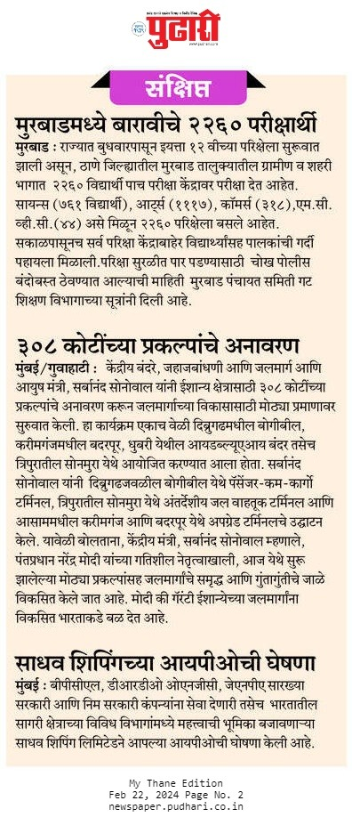
pudhari, cat A, page 3

Slide 25
Loksatta , cat A ,page 9, date 21 feb

Slide 26
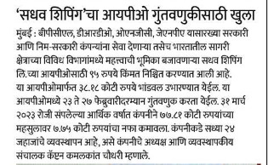
SAKAL, CAT A, PAGE 7, Date:-21-Feb-24, Page no.6

Slide 27
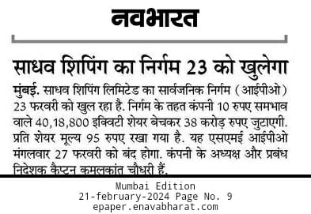
Navbharat, cat A, page 9, date 22 feb

Slide 28
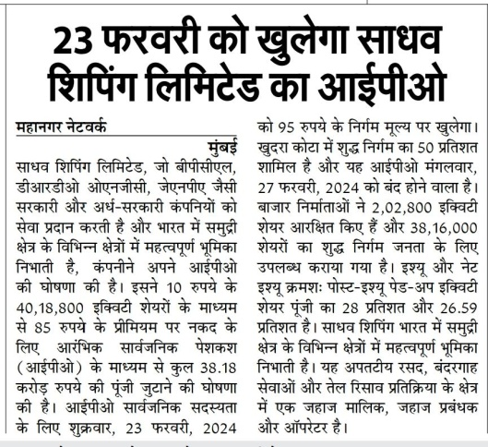
Hamara mahanagar, page 5, date 21 feb ,

Slide 29
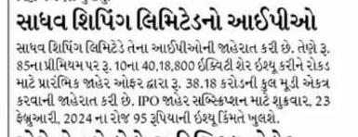
Divya bhaskar , cat A, page 5, date 22 feb

Slide 30
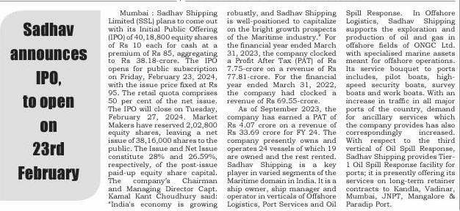
Active times , page 2, date 21 feb

Slide 31
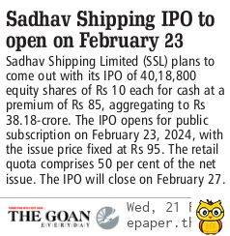
The goan , cat A, page 6, date 21 feb

Slide 32
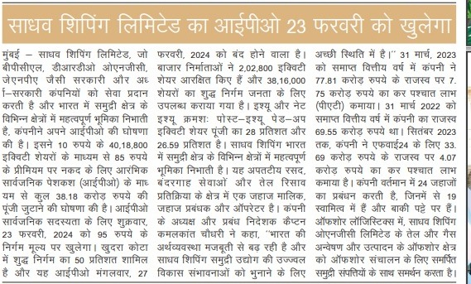
SIDDHANT SAMACHAR, PAGE 2, DATE 21 FEB

Slide 33
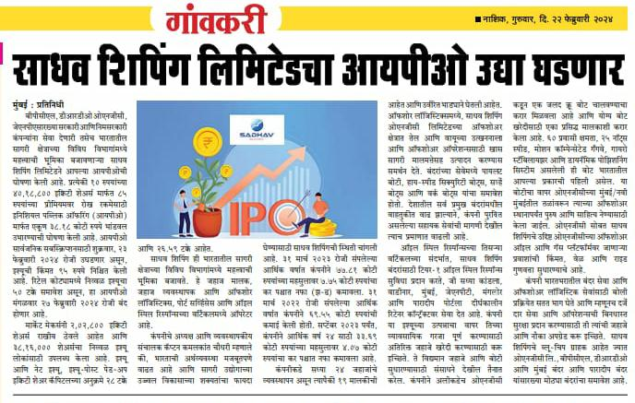
Gavkari , cat A, page 8, date 21 feb

Slide 34
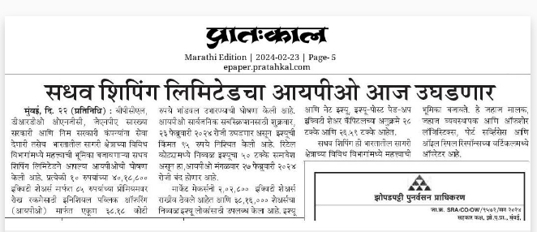
Pratahkal , page 6, date 23 feb

Slide 35
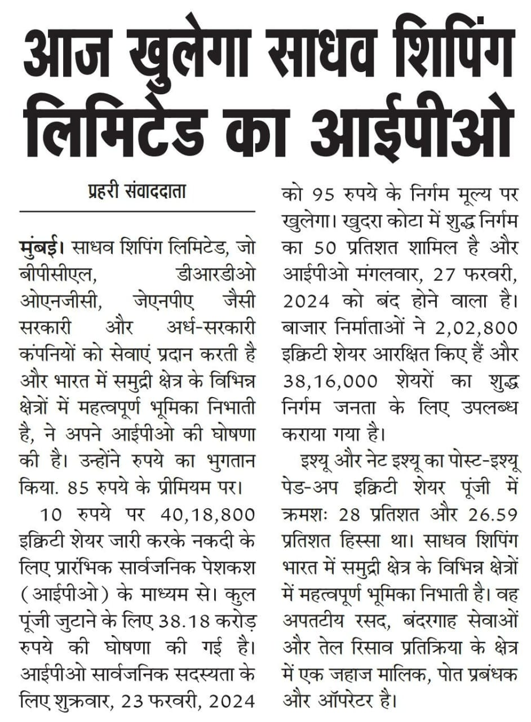
Nyay Ka Prahari, Date:-23 feb, Page no.08

Slide 36
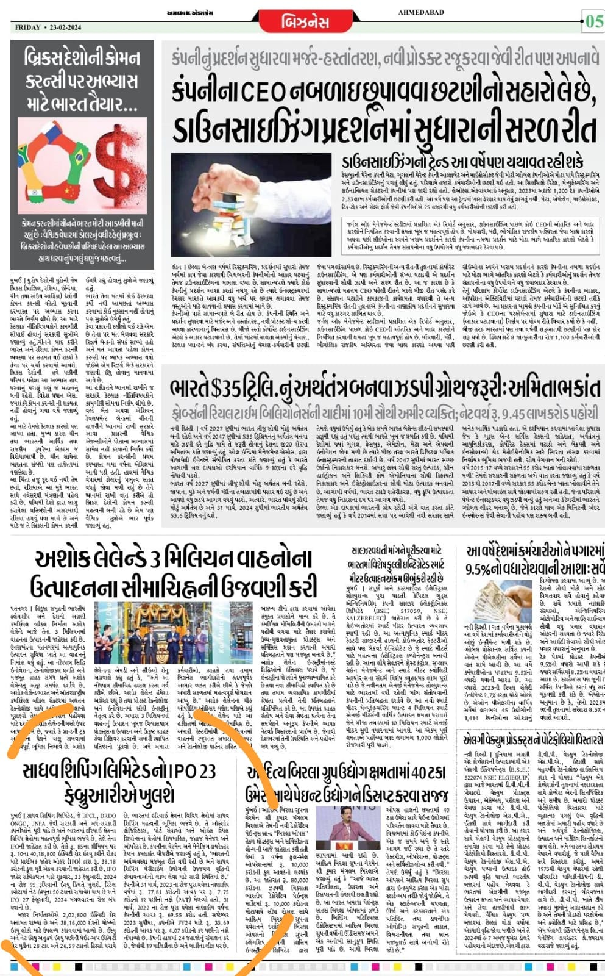
Ahmadabad express, Date:-23-Feb-24, Page no.5

Slide 37
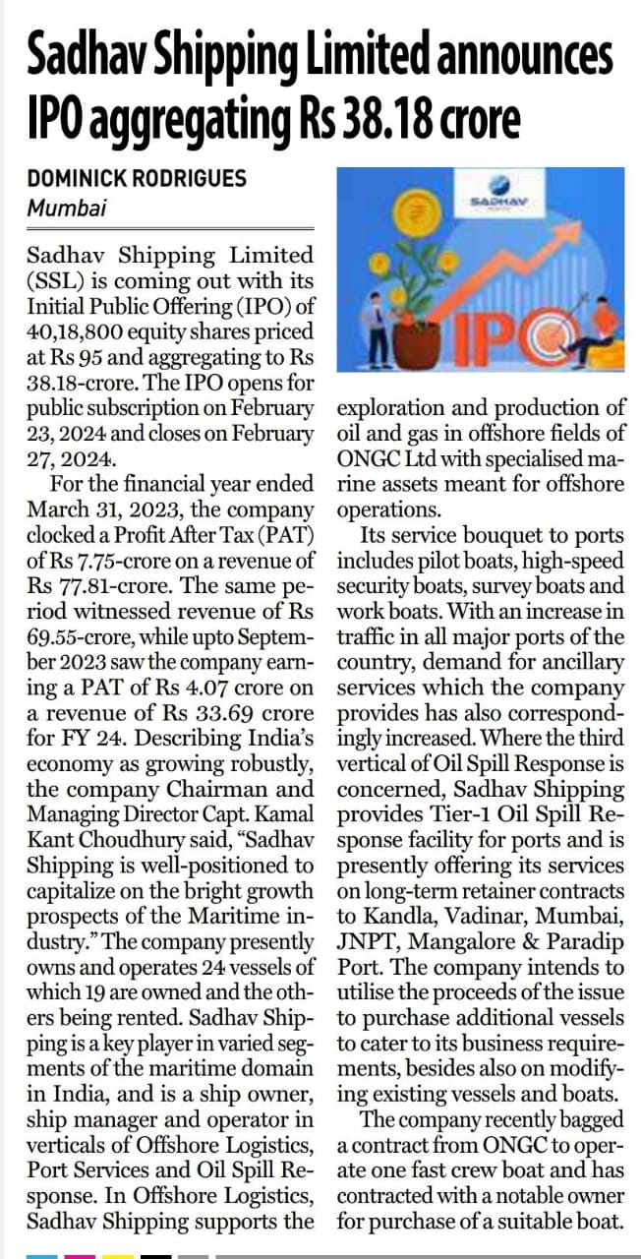
The financial world, Date:-21-Feb-24, Page no.6

Slide 38
The financial world, Date:-21-Feb-24, Page no.6

Slide 39
The financial world, Date:-21-Feb-24, Page no.6

Slide 40
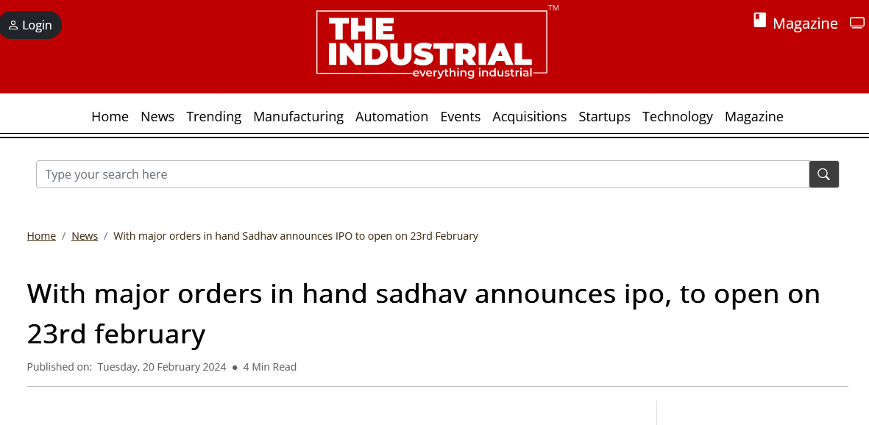
https://www.theindustrial.in/news/f5245f9f0d/With-major-orders-in-hand-Sadhav-announces-IPO-to-open-on-23rd-February

Slide 41
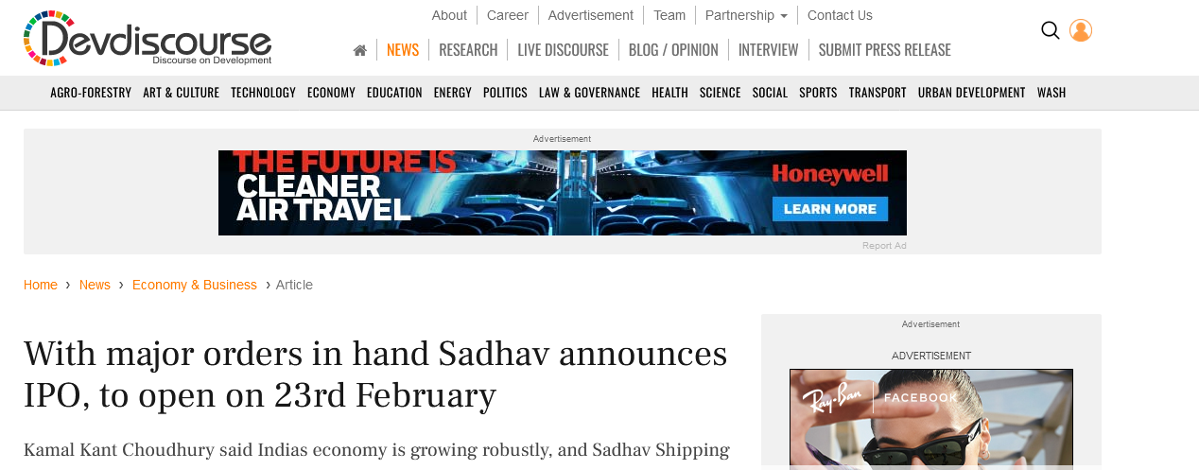
https://www.devdiscourse.com/article/headlines/2834519-with-major-orders-in-hand-sadhav-announces-ipo-to-open-on-23rd-february

Slide 42
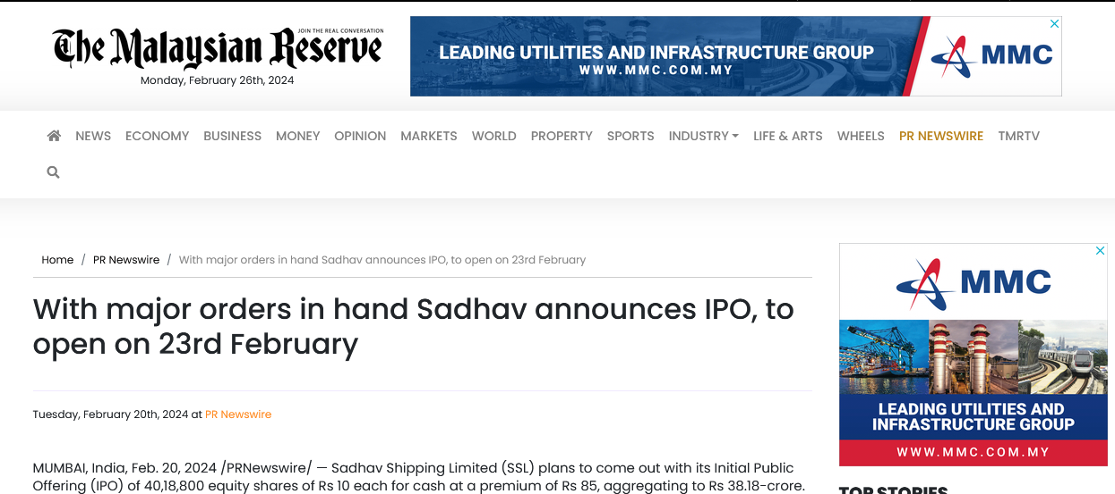
https://themalaysianreserve.com/2024/02/20/with-major-orders-in-hand-sadhav-announces-ipo-to-open-on-23rd-february/

Slide 43
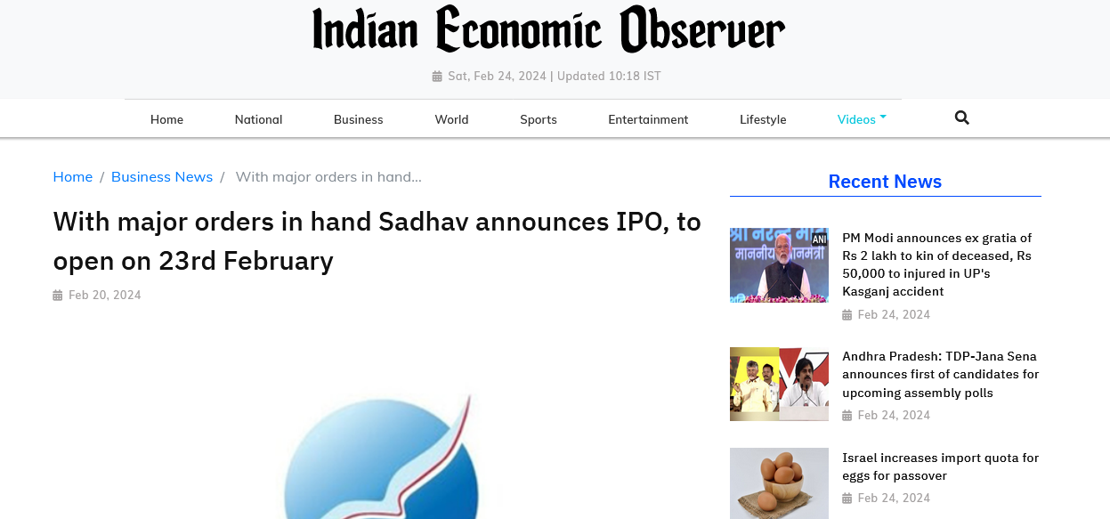
https://www.indianeconomicobserver.com/news/with-major-orders-in-hand-sadhav-announces-ipo-to-open-on-23rd-february20240220162908/

Slide 44
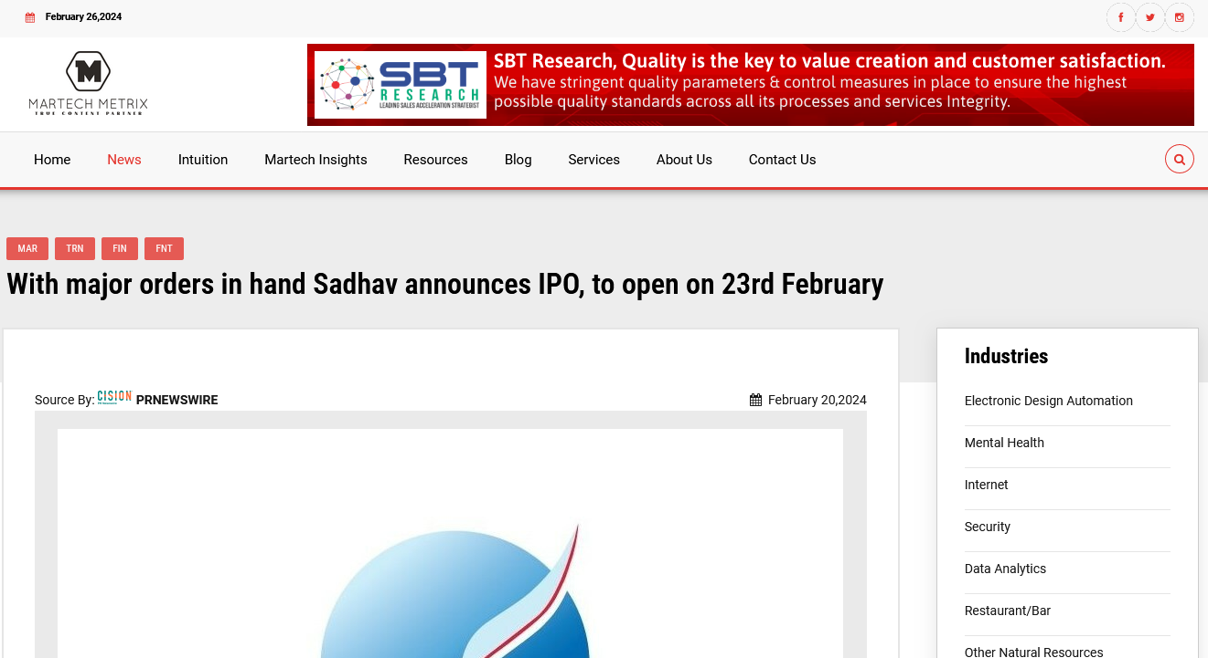
https://martechmetrix.com/news/with-major-orders-in-hand-sadhav-announces-ipo-to-open-on-23rd-february

Slide 45
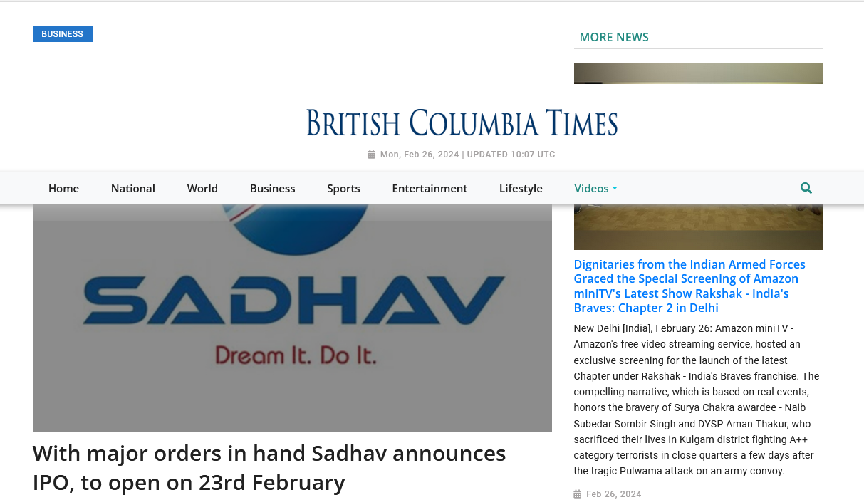
https://www.britishcolumbiatimes.com/news/with-major-orders-in-hand-sadhav-announces-ipo-to-open-on-23rd-february20240220162908/

Slide 46
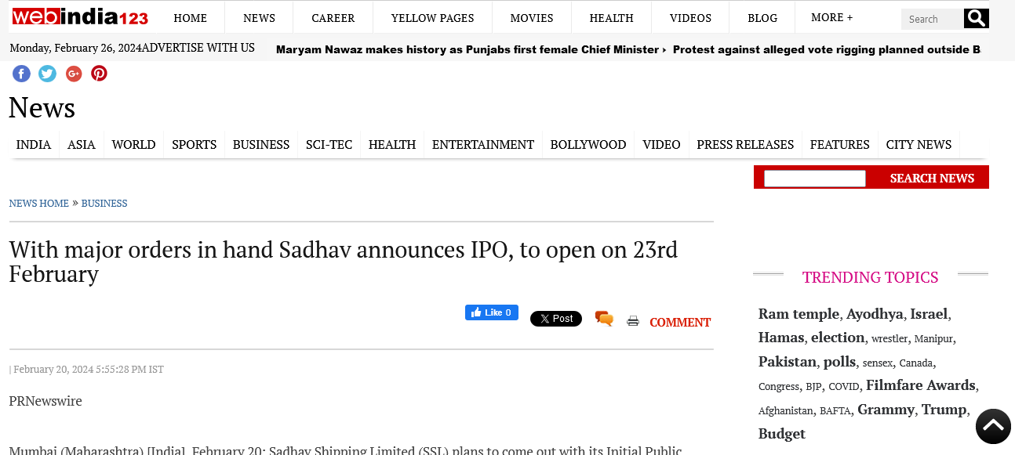
https://news.webindia123.com/news/articles/Business/20240220/4170746.html

Slide 47
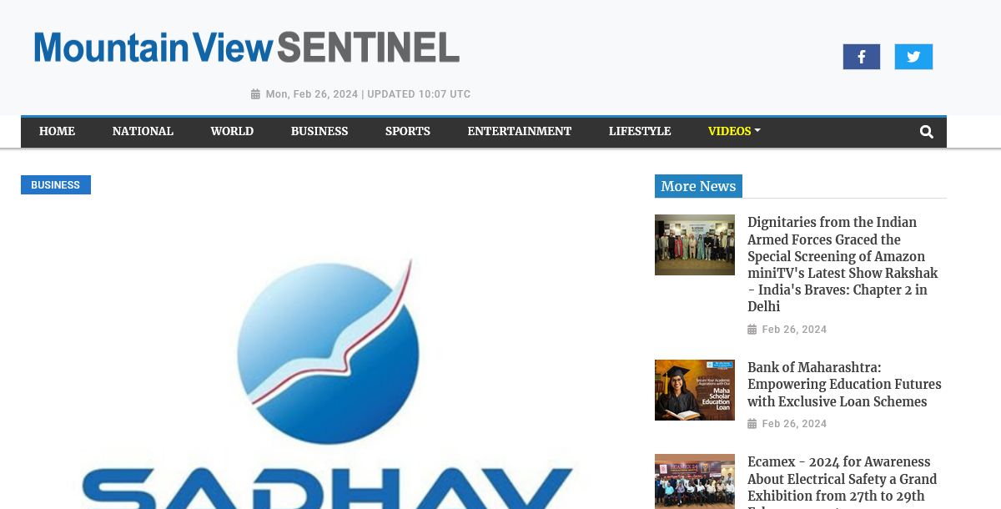
https://www.mountainviewsentinel.com/news/with-major-orders-in-hand-sadhav-announces-ipo-to-open-on-23rd-february20240220162908/

Slide 48
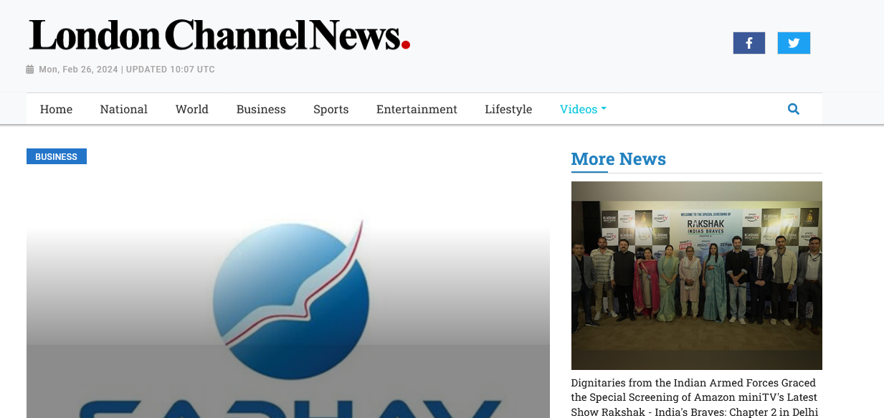
https://www.londonchannelnews.com/news/with-major-orders-in-hand-sadhav-announces-ipo-to-open-on-23rd-february20240220162908/

Slide 49
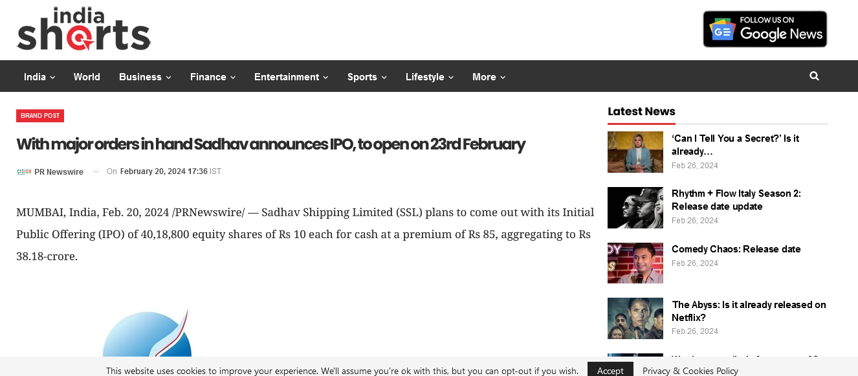
https://indiashorts.com/with-major-orders-in-hand-sadhav-announces-ipo-to-open-on-23rd-february/161830/

Slide 50
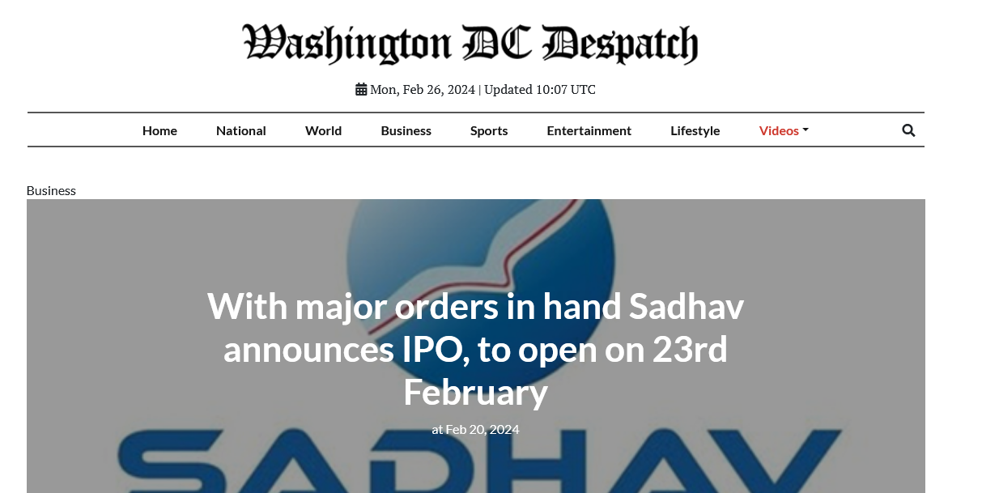
https://www.washingtondcdespatch.com/news/with-major-orders-in-hand-sadhav-announces-ipo-to-open-on-23rd-february20240220162908/

Slide 51
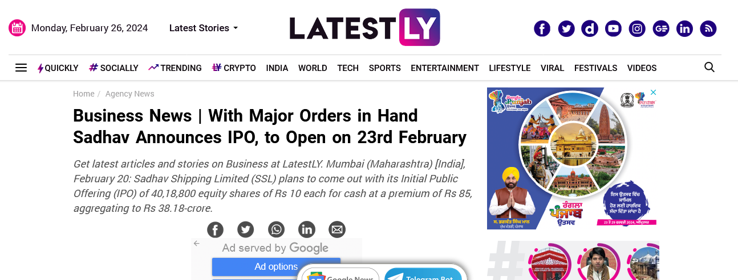
https://www.latestly.com/agency-news/business-news-with-major-orders-in-hand-sadhav-announces-ipo-to-open-on-23rd-february-5771693.html

Slide 52
https://twitter.com/ET_Infra/status/1760257826457256250?s=20

Slide 53
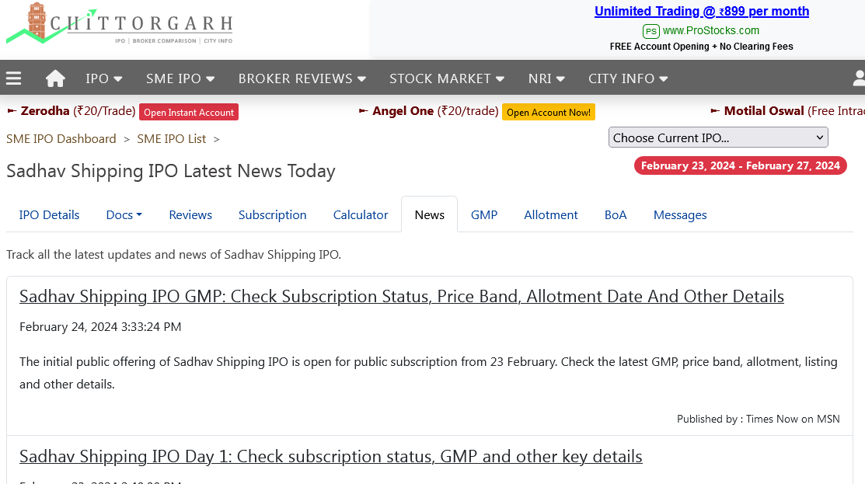
https://www.chittorgarh.com/ipo_news/sadhav-shipping-ipo/1657/

Slide 54
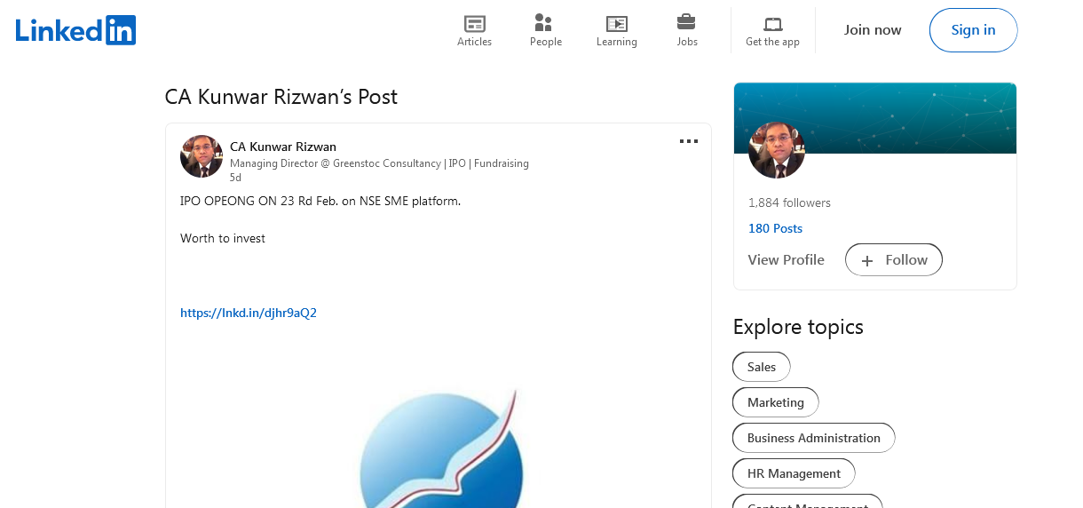
https://www.linkedin.com/posts/ca-kunwar-rizwan_with-major-orders-in-hand-sadhav-announces-activity-7165720267569197057-pYl4

Slide 55
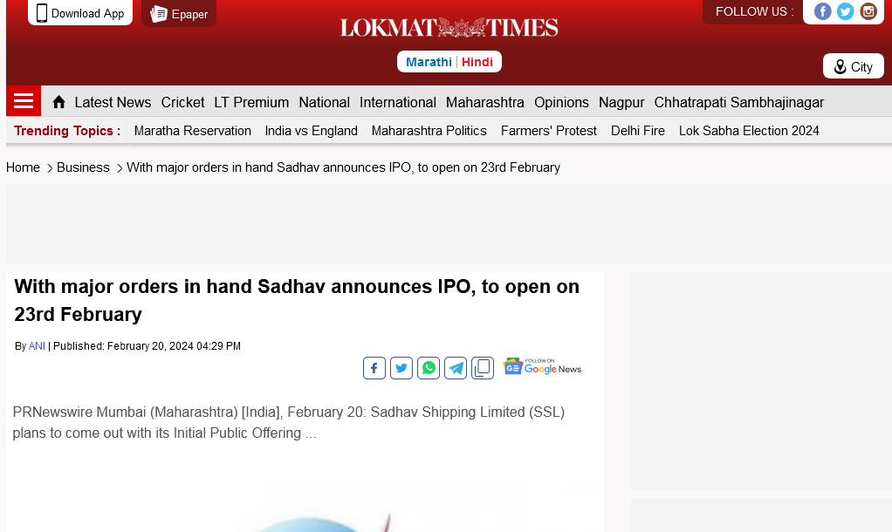
https://www.lokmattimes.com/business/with-major-orders-in-hand-sadhav-announces-ipo-to-open-on-23rd-february

Slide 56
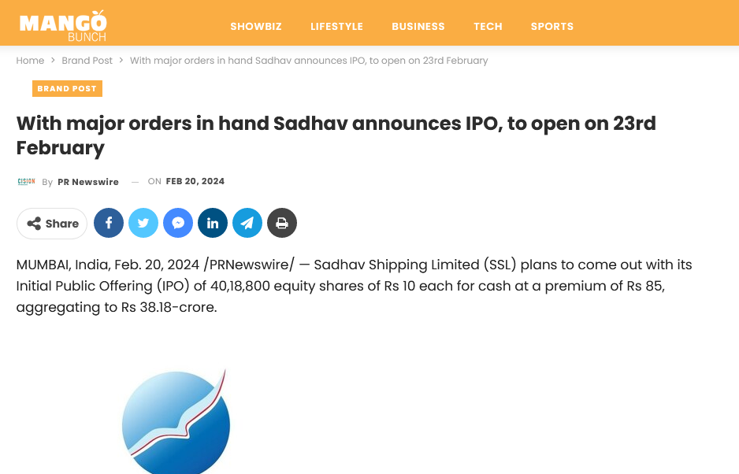
https://mangobunch.in/brand-post/with-major-orders-in-hand-sadhav-announces-ipo-to-open-on-23rd-february/

Slide 57
https://www.businessupturn.com/brand-post/with-major-orders-in-hand-sadhav-announces-ipo-to-open-on-23rd-february/

Slide 58
https://en.jaipurtimes.org/prnewswire?rkey=20240220EN40467&filter=26544

Slide 59
https://www.constructionworld.in/amp/Latest-Construction-News/sadhavs-ipo-marks-maritime-milestone/51376

Slide 60
https://www.jaipur-mirror.com/prnewswire?rkey=20240220EN40467&filter=26530

Slide 61
https://www.ndtvprofit.com/ipos/sadhav-shipping-announces-ipo-to-open-on-feb-23

Slide 62
https://infra.economictimes.indiatimes.com/news/ports-shipping/with-major-orders-in-hand-sadhav-announces-ipo-to-open-on-23rd-feb/107881316#:~:text=Sadhav%20Shipping%20Limited%20(SSL)%20plans,aggregating%20to%20Rs%2038.18%2Dcrore

Slide 63
https://www.maritimegateway.com/tag/sadhav-shipping/

Slide 64
https://www.aninews.in/topic/public-subscription/

Slide 65
https://dailyindianews.com/with-major-orders-in-hand-sadhav-announces-ipo-to-open-on-23rd-february/2024/305635/

Slide 66
http://lucky-wap-ams.op-mobile.opera.com/detail/7219c4b1240220en_zm?uid=9323e2792fcedc45b4ddabd7acd9e8a2&country=zm&language=en&time=1+day+ago&category=sports&page=9

Slide 67
https://www.angelone.in/upcoming-ipo

Slide 68
https://www.5paisa.com/gujarati/sme-ipo/sadhav-shipping-ltd-ipo

Slide 69
https://www.bscnursing2022.com/sadhav-shipping-ipo/

Slide 70
http://www.estrade.in/news/pr-newswire/?start=3&filter=4950

Slide 71
https://www.motilaloswal.com/ipos

Slide 72
https://www.chittorgarh.com/ipo_news/dynamic-cables-ipo/774/

Slide 73
https://marathi.hindusthansamachar.in/Encyc/2024/2/20/Sadhav-Shipping-Limited-IPO-open-23rd-February.php

Slide 74
https://newshublilve.blogspot.com/2024/02/sadhav-shipping-limited-announces-ipo.html

Slide 75
https://www.thefinancialworld.com/sadhav-shipping-limited-announces-ipo-aggregating-rs-38-18-crore/

Slide 76
https://epaper.loksatta.com/article/Mumbai-marathi-epaper?OrgId=2222298f2a2&eid=7&imageview=0&device=desktop

Slide 77
https://mtinews.in/sadhav-announces-ipo-to-open-on-23rd-february/

Slide 78
Other Links

Slide 79
http://winningbizness.in/business-news-feeds.html?rkey=20240220EN40467&filter=24596 https://www.varindia.com/news/press--pr-news-wire?rkey=20240220EN40467&filter=537 https://uttarakhandnewsnetwork.com/press-release-pr-news-wire/?rkey=20240220EN40467&filter=14497
https://www.uniindia.com/with-major-orders-in-hand-sadhav-announces-ipo-to-open-on-23rd-february/prnewswire/news/3146977.html http://timestech.in/trends-forecast/?rkey=20240220EN40467&filter=15939 https://www.thinkingtech.in/pr-newswire/?rkey=20240220EN40467&filter=17106
https://theprint.in/ani-press-releases/with-major-orders-in-hand-sadhav-announces-ipo-to-open-on-23rd-february/1972564/ https://thebizzstories.com/prnewswire?rkey=20240220EN40467&filter=23904 https://the-good.in/pr-newswire/?rkey=20240220EN40467&filter=22019 http://www.thereportingtoday.com/newswire/?rkey=20240220EN40467&filter=20784

Slide 80
https://www.talkpedia.in/prnewswire?rkey=20240220EN40467&filter=26504 https://startagist.com/pr-newswire/?rkey=20240220EN40467&filter=20995 https://www.sptimes.in/prnewswire?rkey=20240220EN40467&filter=23469 https://spoindia.org/press-pr-newswire/?rkey=20240220EN40467&filter=20001 https://www.socialnews.xyz/pr-newswire/?rkey=20240220EN40467&filter=15405 https://www.shubh24.com/prnewswire?rkey=20240220EN40467&filter=26588 https://www.sangritv.com/prnewswire?rkey=20240220EN40467&filter=26566 https://www.sangritoday.com/spotlight/prnewswire?rkey=20240220EN40467&filter=22762 https://en.sangritimes.com/prnewswire?rkey=20240220EN40467&filter=21009 https://www.sanchoretoday.com/prnewswire?rkey=20240220EN40467&filter=26580 https://www.sabkhojnews.com/prnewswire?rkey=20240220EN40467&filter=26532

Slide 81
https://reviewstreet.in/news-reviews-mobiles-gadgets-pcs-automobile/prnewswireindia/?rkey=20240220EN40467&filter=15937
https://reportstory.com/pr-newswire/?rkey=20240220EN40467&filter=19806 https://readbox.in/pr-newswire/?rkey=20240220EN40467&filter=22117 https://www.rajasthanhorizon.com/prnewswire?rkey=20240220EN40467&filter=26546 https://www.ptinews.com/press-release/With-major-orders-in-hand-Sadhav-announces-IPO--to-open-on-23rd-February/1303787 http://www.prativad.com/Newswireeng.php?rkey=20240220EN40467&filter=19411 https://www.prnewswire.com/in/news-releases/with-major-orders-in-hand-sadhav-announces-ipo-to-open-on-23rd-february-302065900.html https://policenama.com/infocus?rkey=20240220EN40467&filter=23024 https://planetreport.in/pr-newswire/?rkey=20240220EN40467&filter=22017 https://perfectnews.live/prnewswire/?rkey=20240220EN40467&filter=21266

Slide 82
http://odishanewstune.com/press-releases/?rkey=20240220EN40467&filter=19427 http://www.odishabytes.com/pr-newswire/?rkey=20240220EN40467&filter=18897 https://nrinews24x7.com/pr-newswire/?rkey=20240220EN40467&filter=25334 https://www.newznew.com/press-releases/?rkey=20240220EN40467&filter=16908 http://www.newsr.in/prnewswire.php?rkey=20240220EN40467&filter=5070 https://en.newsbolt.in/prnewswire?rkey=20240220EN40467&filter=26674 https://www.newsblare.com/pr-newswire/?rkey=20240220EN40467&filter=20902 https://newsdeck.in/pr-newswire/?rkey=20240220EN40467&filter=22015 https://newschronicle.in/pr-newswire/?rkey=20240220EN40467&filter=20256 https://www.newdelhitimes.com/news-release/?rkey=20240220EN40467&filter=5147 https://www.nationrepubliq.com/prnewswire?rkey=20240220EN40467&filter=26570 https://nasheman.in/newswire/?rkey=20240220EN40467&filter=11016

Slide 83
http://www.onenewspage.com/prnewswire.php?rkey=20240220EN40467&filter=3968 http://odisharay.com/pressreleases.php?rkey=20240220EN40467&filter=20944
https://mybrandbook.co.in/redirect.php?p=11431&rkey=20240220EN40467&filter=19999 http://mtinews.in/press-releases/?rkey=20240220EN40467&filter=1971 https://mediabulletins.com/pr-newswire/?rkey=20240220EN40467&filter=4605 https://mbi24.marudharabharti.com/prnewswire?rkey=20240220EN40467&filter=26524 https://www.marudharbharti.com/prnewswire?rkey=20240220EN40467&filter=26538 https://en.marudharaaina.com/p/prnewswire.html?rkey=20240220EN40467&filter=26600 https://en.marudharabharti.com/prnewswire?rkey=20240220EN40467&filter=26542 https://www.manifoldtimes.com/pr-newswire/?rkey=20240220EN40467&filter=20785
https://mangobunch.in/brand-post/with-major-orders-in-hand-sadhav-announces-ipo-to-open-on-23rd-february/

Slide 84
http://www.mangalorean.com/pr-newswire/?rkey=20240220EN40467&filter=17665 https://livechronicle.in/pr-newswire/?rkey=20240220EN40467&filter=22011
https://www.jatchronicle.com/prnewswire?rkey=20240220EN40467&filter=26584 https://en.jalorelive.com/prnewswire?rkey=20240220EN40467&filter=26564 https://en.jaipurtimes.org/prnewswire?rkey=20240220EN40467&filter=26544 https://www.jaipur-mirror.com/prnewswire?rkey=20240220EN40467&filter=26530 https://indianspectator.com/prnewswire/?rkey=20240220EN40467&filter=21881 http://indiancatwalk.com/press-release/?rkey=20240220EN40467&filter=22868 https://www.indiatoday.in/pr-newswire?rkey=20240220EN40467&filter=4315
https://indiashorts.com/with-major-orders-in-hand-sadhav-announces-ipo-to-open-on-23rd-february/161830/ http://news.indiaonline.in/prnewswire?rkey=20240220EN40467&filter=4991

Slide 85
http://www.hellomumbainews.com/hello-business/?rkey=20240220EN40467&filter=12313 https://groundreport.in/pr-news-english-2/?rkey=20240220EN40467&filter=20940 https://greentechlead.com/latest-news?rkey=20240220EN40467&filter=15489 https://goodreport.in/pr-newswire/?rkey=20240220EN40467&filter=22013 https://goearth.in/pr-newswire/?rkey=20240220EN40467&filter=20252 https://founderlabs.in/pr-newswire/?rkey=20240220EN40467&filter=25308 https://www.famousnow.in/prnewswire?rkey=20240220EN40467&filter=26590 https://www.famousinsider.com/prnewswire?rkey=20240220EN40467&filter=26594 http://www.estrade.in/news/pr-newswire/?rkey=20240220EN40467&filter=4950 https://www.ekaainabharat.com/en/prnewswire?rkey=20240220EN40467&filter=26554 http://www.ecargolog.in/pr-news/?rkey=20240220EN40467&filter=4814 https://earthnews4u.com/pr-newswire/?rkey=20240220EN40467&filter=20250

Slide 86
https://digitalconqurer.com/prnewswire/technology/?rkey=20240220EN40467&filter=3833 https://info.creditriskmonitor.com/NewsStory.aspx?NewsId=42405408&AK=Nina
https://www.businessupturn.com/brand-post/with-major-orders-in-hand-sadhav-announces-ipo-to-open-on-23rd-february/
https://www.businesstoday.in/prnewswire/?rkey=20240220EN40467&filter=2418 http://businessnewsthisweek.com/prnews/?rkey=20240220EN40467&filter=601 https://brandife.com/prnewswire/?rkey=20240220EN40467&filter=25573 https://www.bollyorbit.com/prnewswire?rkey=20240220EN40467&filter=26510 http://www.biznextindia.com/pr-newswire/?rkey=20240220EN40467&filter=19403 http://www.bizwireexpress.com/showstoryPRN.php?rkey=20240220EN40467&filter=2276 https://news.biharprabha.com/prnewswire/?rkey=20240220EN40467&filter=2270 https://en.barmerbulletin.com/prnewswire?rkey=20240220EN40467&filter=26672

Slide 87
https://imp.news/prnw/?rkey=20240220EN40467&filter=23444 https://ibgnews.com/pr-newswire-news/?rkey=20240220EN40467&filter=19585 http://www.bangalorewaves.com/news/bangalorewaves-business-news.php?rkey=20240220EN40467&filter=2267 https://alltechmagazine.com/press-releases/?rkey=20240220EN40467&filter=25603 https://www.agrnews.co.in/prnewswire?rkey=20240220EN40467&filter=26608 http://www.5dariyanews.com/Full-Story-Latest-from-PR-Newswire.aspx?rkey=20240220EN40467&filter=1835 https://www.talkpedia.in/prnewswire?rkey=20240220EN40467&filter=26504 http://bankingfrontiers.com/pr-newswire/?rkey=20240220EN40467&filter=3021 https://www.hellocelebs.in/prnewswire?rkey=20240220EN40467&filter=26574 http://www.hydnews.net/pr-newswire?rkey=20240220EN40467&filter=20977 https://reportstory.com/pr-newswire/?rkey=20240220EN40467&filter=19806

